Slide 1
South Atlantic Convergence Zone
SACZ

Slide 2
SACZ
A heavy rainfall producing non-baroclinic boundary that under favorable MJO/Atmospheric Kelvin wave conditions forms over South America during the summer months.
It typically spans between the Amazon River basin and the Southeast states of Brazil.
Subtropical Ridge/Bolivian High supplies the upper divergence/deep convection ventilation.
Evident as a trough anchoring on a closed low over Brazil, with well defined axis at 850 and 700 hPa.

Slide 3
SACZ
ENSO’s Influence
Warm ENSO (El Niño): Focus of the activity shifts south across Paraguay to northern Argentina/Uruguay
Cold ENSO (La Niña): Focus of the convection between Southeast Brazil and northern Bolivia-Acre/Rondonia.
MJO and Atmospheric Kelvin Waves
The divergent phase of the MJO increases the chances of the SACZ forming and of longer duration.
Kelvin waves also tend to enhance SACZ related convection, particularly when in phase with a divergent pulse of the MJO.
The Kelvin Waves, however, tend to be of shorter duration (2-3 days)

Slide 4
SACZ Forecasting
Model Guidance: look for a persistent low/mid level trough forming north of a baroclinic boundary
Well defined trough at 850 and 700 hPa
Lasting 3-7 days
Moisture converges along this trough.
Td > 20-24C
Blocks moisture transport to central/ northern South America.

Slide 5
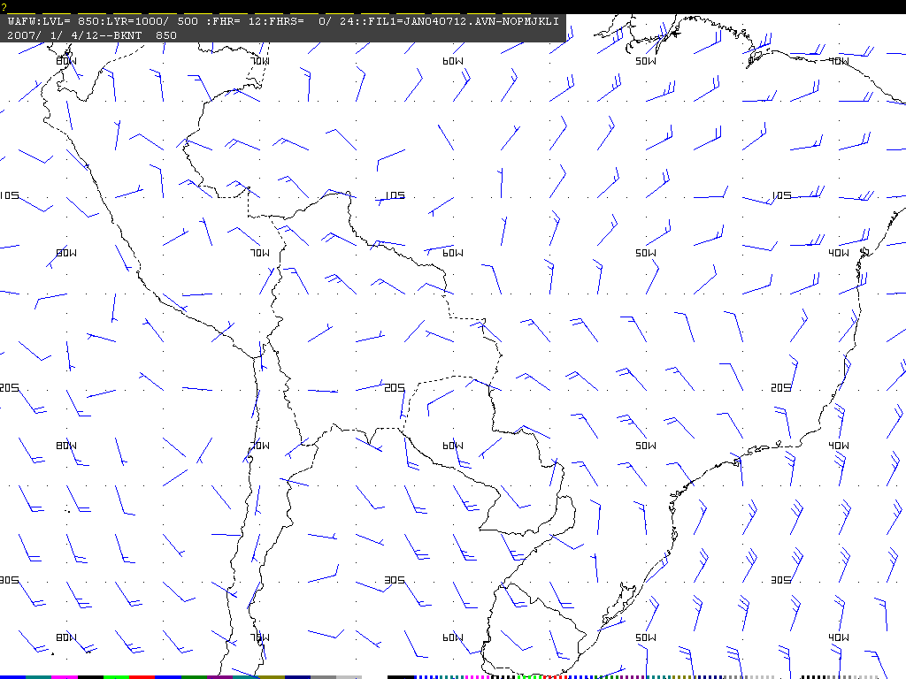
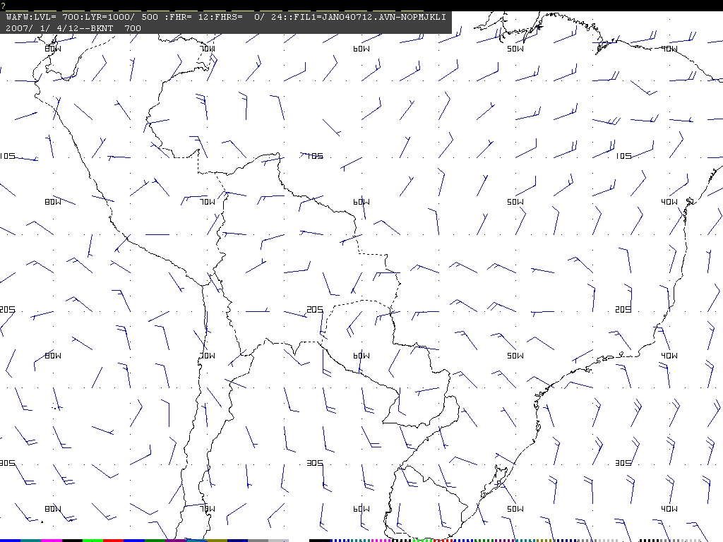
SACZ Analysis and Forecast
850 hPa Winds
L
700 hPa Winds
At 850 hPa, it typically anchors on a closed low
At 700 hPa, it often manifests as an open trough

Slide 6
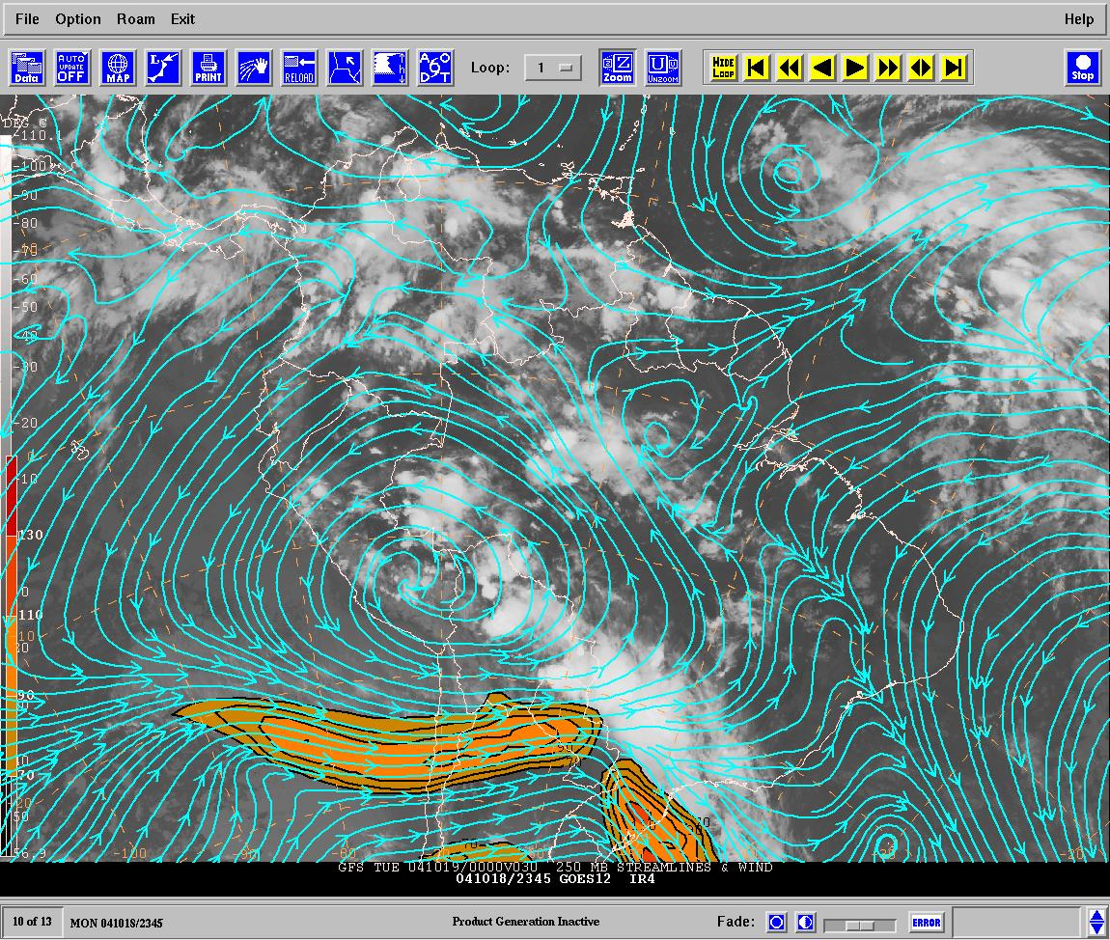
200 hPa Stream Lines and IR
Notes:
La Alta de Bolivia en altura nos da la ventilación en apoyo de la convección profunda.

Slide 7
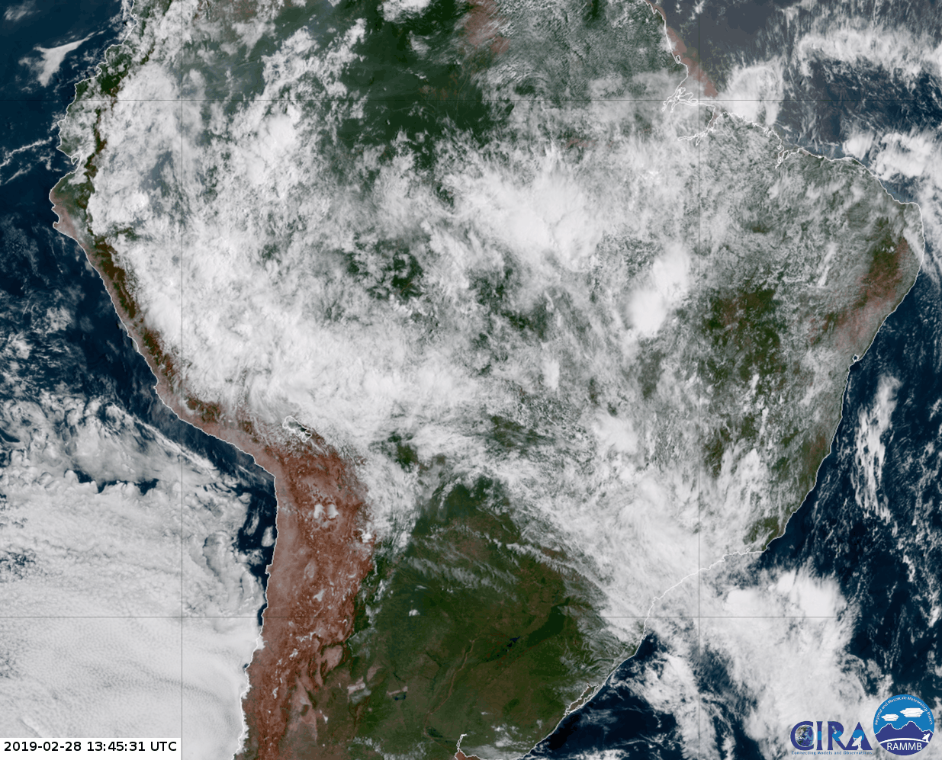
SACZ – Feb 2019
L
Notes:
ZCAS/SACZ típicamente se extiende sobre el sureste de Brasil-Bolivia a Perú. Buena región para la formación de convección profunda, con convección mas intensa formándose al este y norte de la vaguada en niveles bajos.

Slide 8
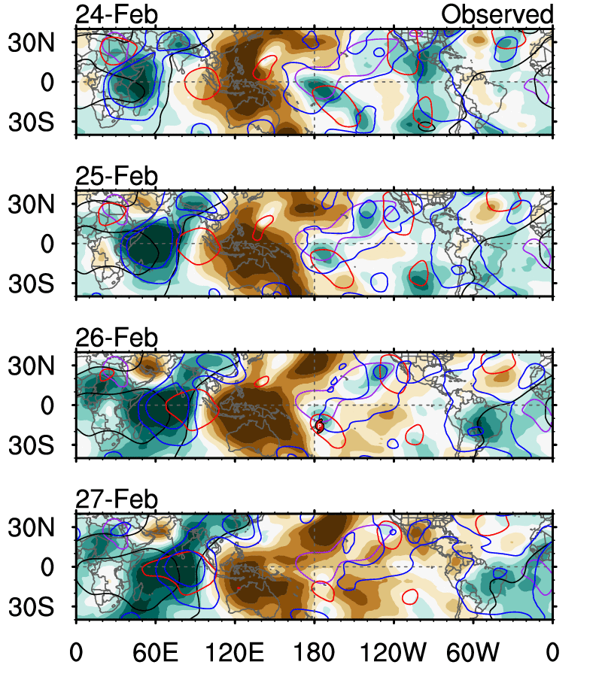
MJO & Atmospheric Kelvin Waves

Slide 9
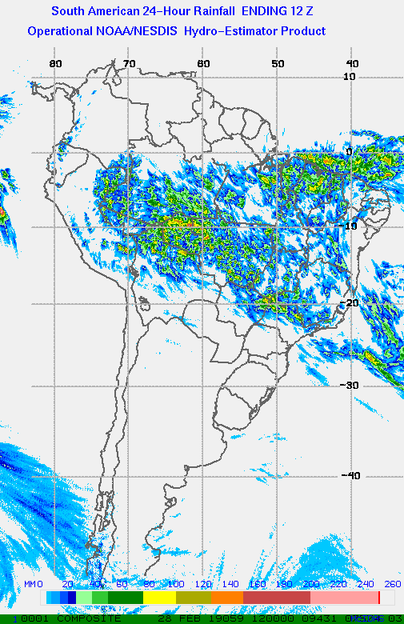
24 hrs Rainfall amounts:
4-8” over Rondonia- northern Bolivia
4-5” over Southeast Brazil

