Slide 1
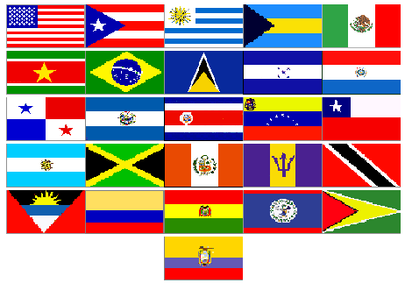
Weather Prediction Center International Desks
Mr. Michel Davison, Chief Dr. Jose M. Galvez, Research Assistant

Slide 2
Historical Background
Desks Established by the USNWS Director
1988-1989: South American Desk begins
Support with Niño Southern Oscillation and drought over Srn Brazil, Uruguay, Nrn Argentina
Short term relief evolves to formal training, as per NWS Director Dr. Joe Friday.
1992-1993: Tropical Desk begins
As the result of RA-IV weather service directors requests to the NWS Director, training was expanded to include Caribbean Basin Countries
1998-2002: Saudi Desk
NWS experts evaluating the Saudi Arabian weather service recommend a Desk at the HPC to help them improve weather forecasting/NWP capabilities (1999-2002)
2012: Fulltime Researcher joins team
Reduced dependence on DTB for coverage at the desks
Improved training

Slide 3
Training Strategy
Train meteorologists on a methodology for weather analysis and forecasting that is independent of working platforms.
They can access info/data readily available through the web and WAFS workstation after they return home.
Allows them to put into practice what they learn
Train the Trainer Concept
Yearly train six students per desk
Students awarded a four-month long fellowship
Two-month overlap between fellows.
Train in an operational environment, focusing their effort on a high-quality product.
This is not a WMO-sponsored vacation!

Slide 4
Training Strategy
In Residence
Four-month long training
12 students per year/ 6 per desks per year
Virtual Training
Once a month through the VISIT program
30-60 participants per training session
On-Site
2-3 training workshops per year
1-2 week long duration
20-40 participants each

Slide 5
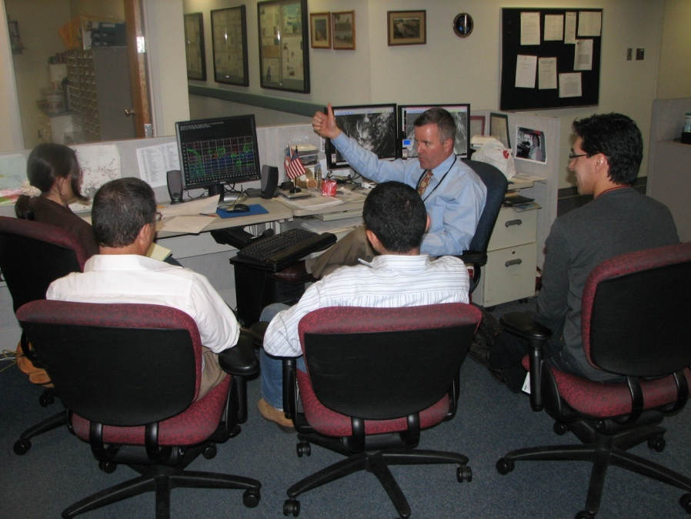
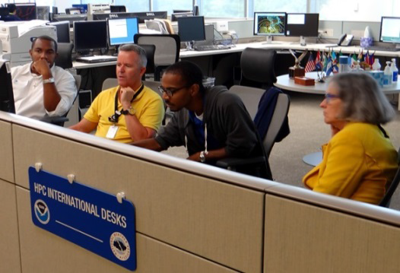
In-Residence Training
Open to operational meteorologists from WMO Regions III and IV
Including: Civilian and Military Forecasters
US Military

Slide 6
In-Residence Training
World Meteorological Organization (WMO) Competencies Standards
Analyze and continually monitor the evolving meteorological and/or hydrological situation
Forecast meteorological and hydrological phenomena and parameters.
WPC Requirement: Become a weather forecasting instructor and mentor
Certification
Certificate of Training
Awarded upon completion of WMO Competencies Standards
COMET Training Modules
Certificate of Attendance

Slide 7
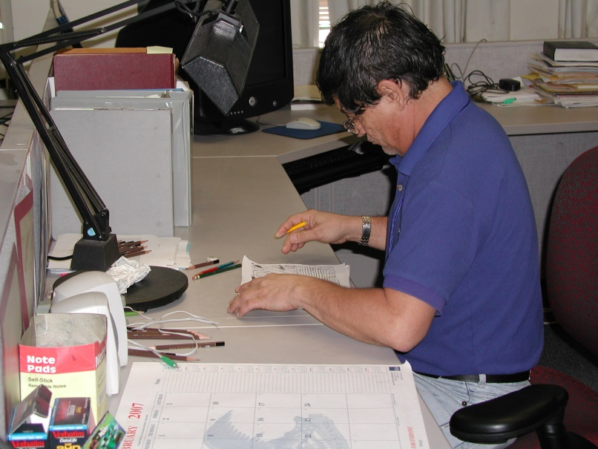
Products Business Hrs: 0600-1500L
South American Desk (RA-III)
Synoptic Discussion
Surface Analysis
Upper Jet Analysis
Forecast Bulletin (Days 1-6)
Forecast Charts (Days 1-6)
Tropical Desk (RA-III/RA-IV)
Prelim Forecast Discussion WSFO SJU
Forecast Bulletin
Forecast Charts (Days 1-4)
QPF Hurricanes
Product Dissemination
Web Based
Global Telecommunications System

Slide 8
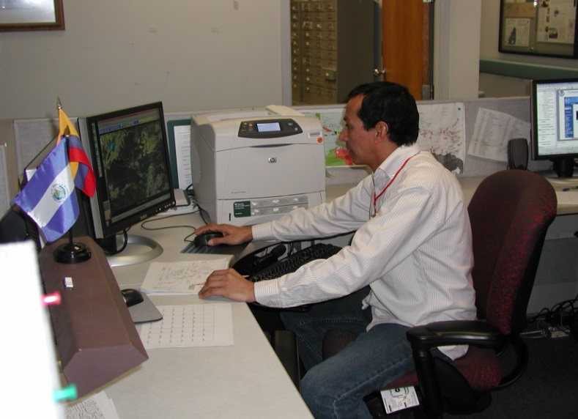
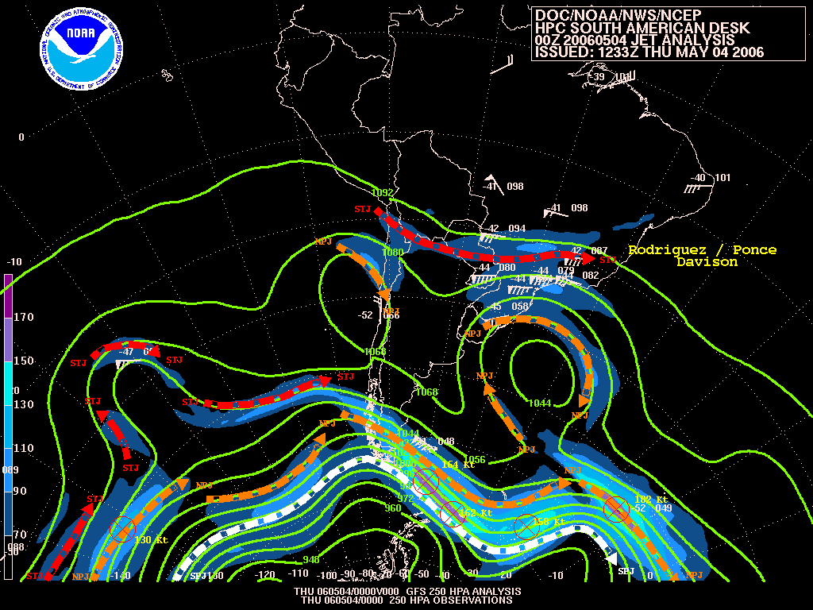
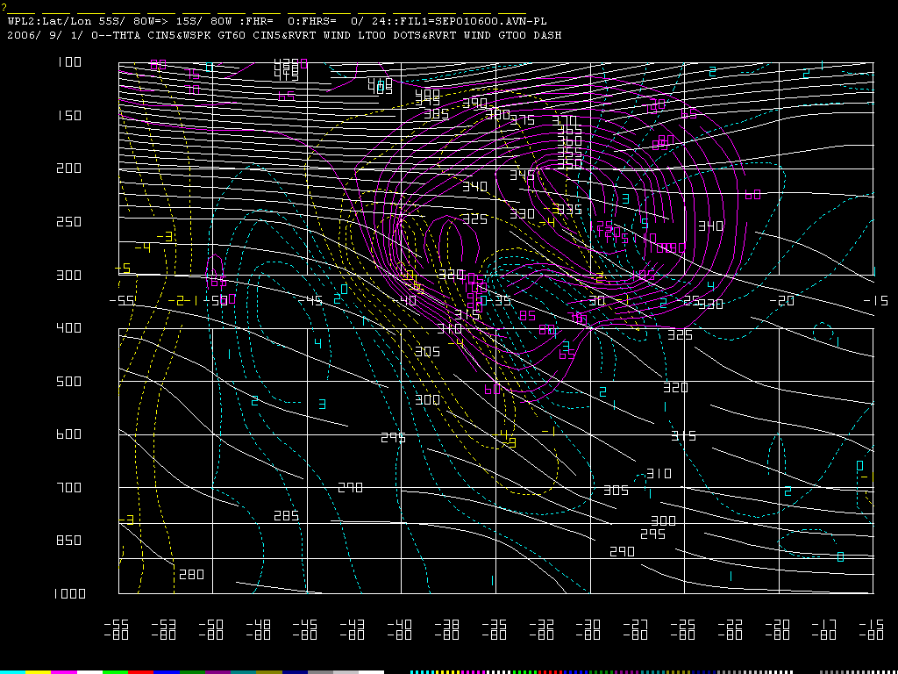
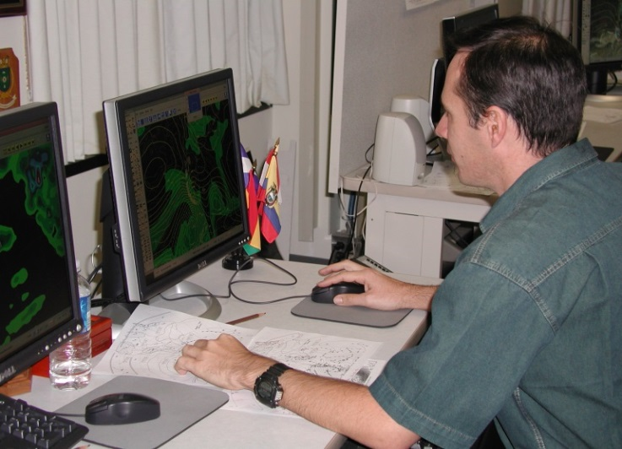
Analysis Charts
00 UTC Jet Analysis
Jets – Vertical Cross Section

Slide 9
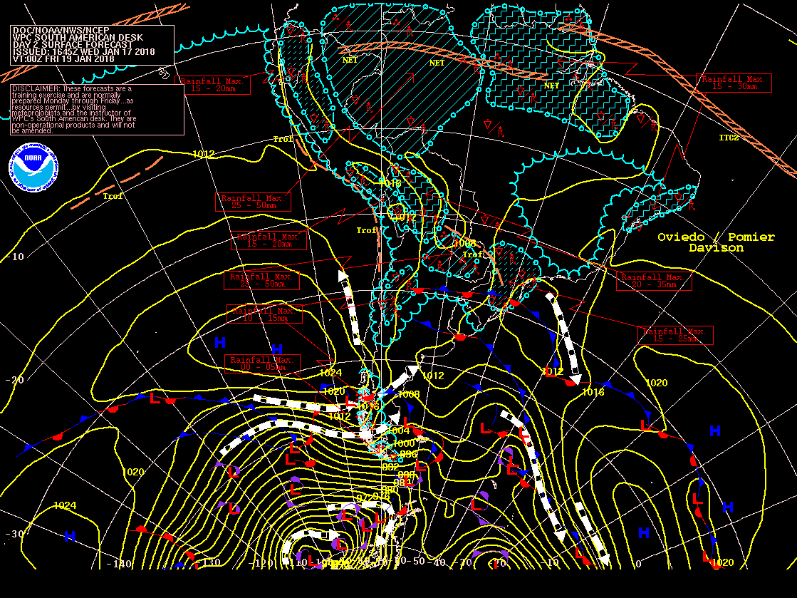
Forecast Charts – South America

Slide 10
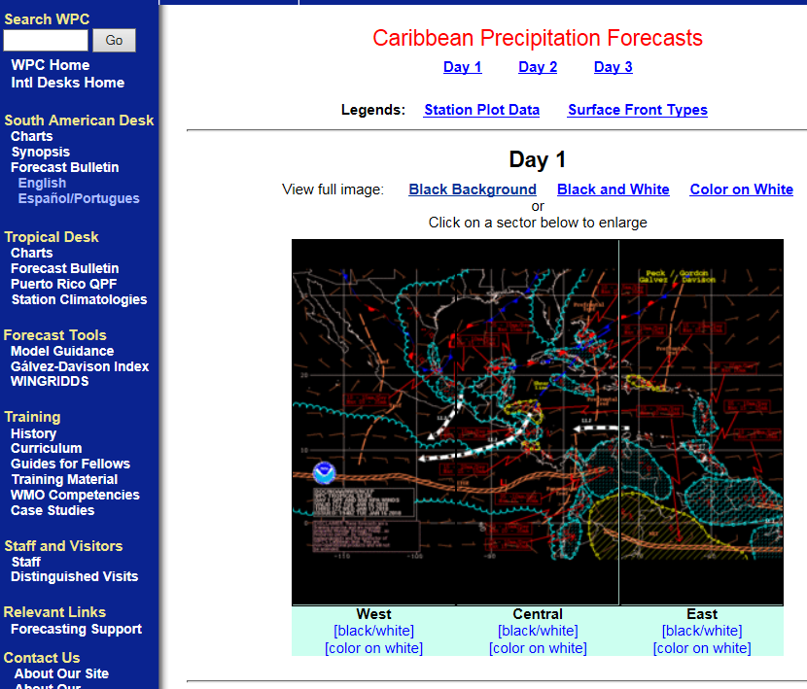
Forecast Charts – Caribbean Basin

Slide 11
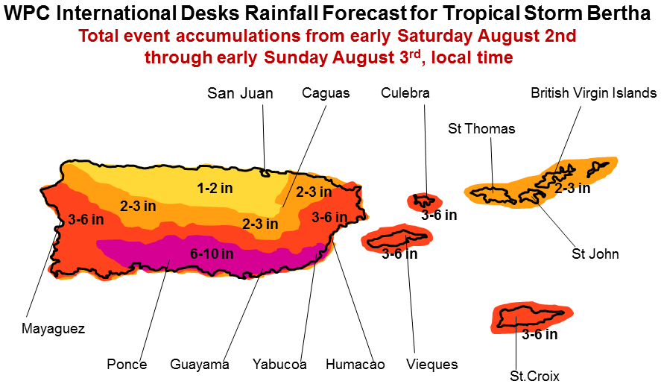
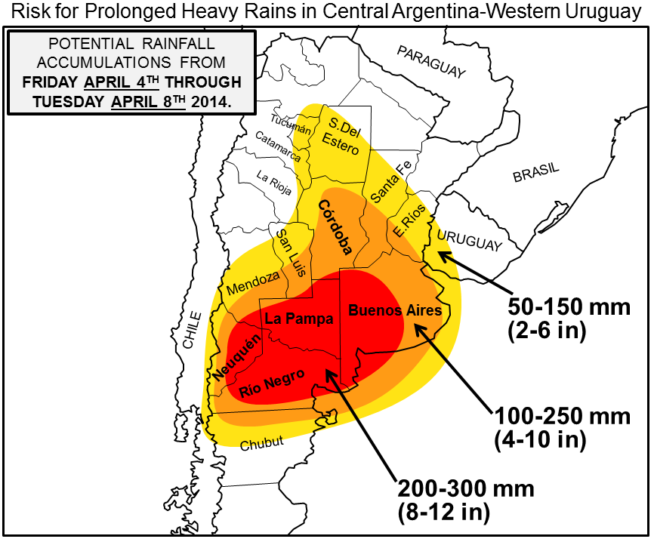
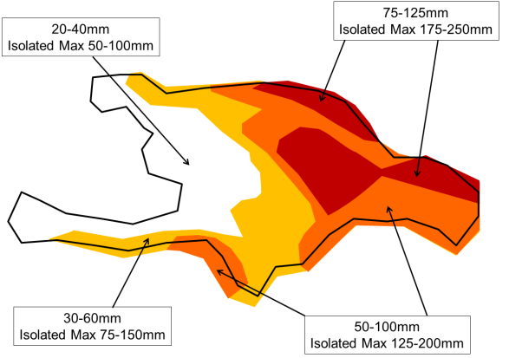
Specialized Support
As required, warn our users of severe weather events
Excessive/persistent rainfall events tend to dominate
Given warning, USAID pre-deploys aid package to affected areas, reducing their response time.

Slide 12
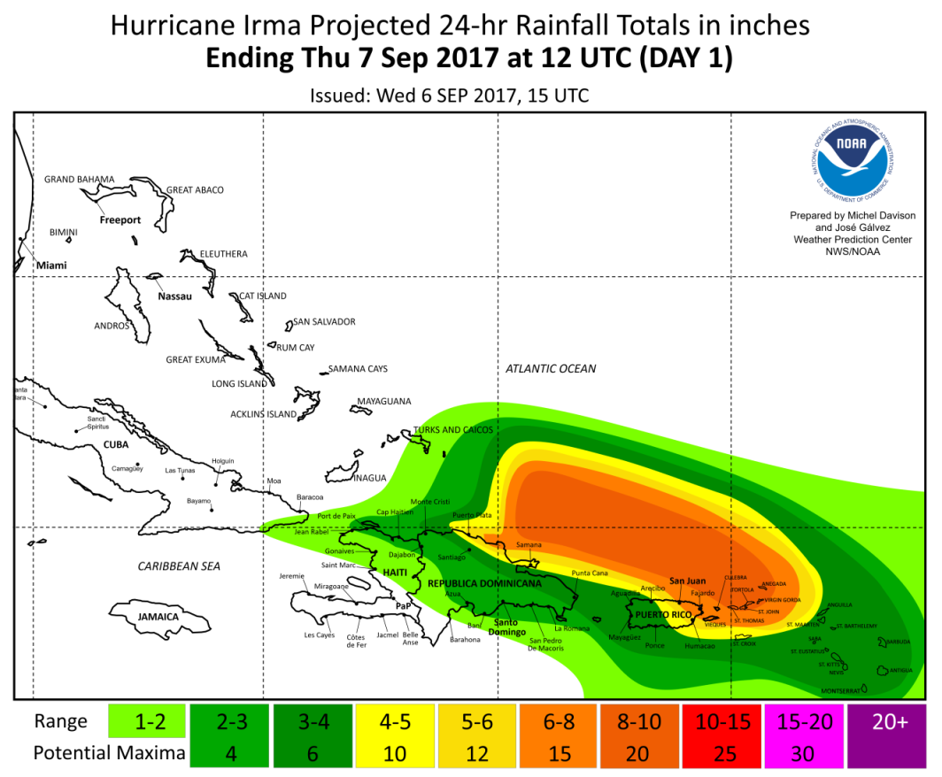
Hurricane Support
WPC provides rainfall statement to the NHC
Based on International Desks’ Forecast
Released to Met Offices, USAID, US Military

Slide 13
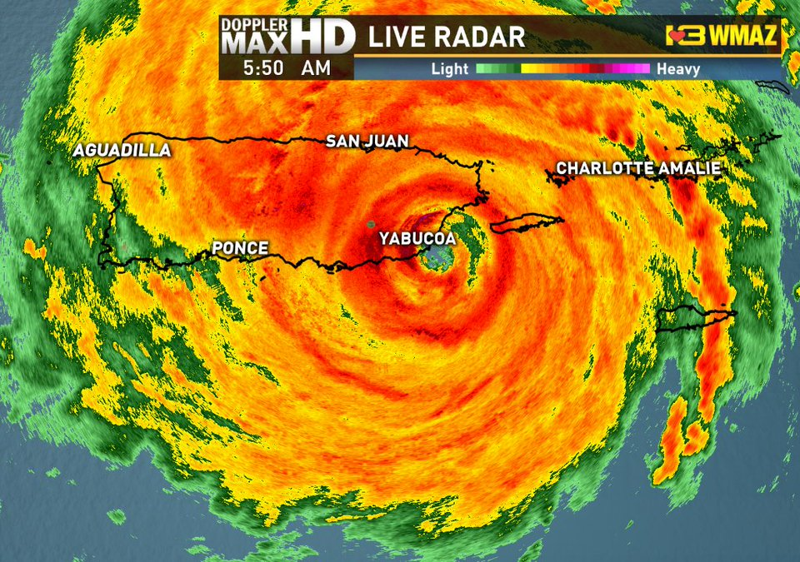
QPF support to Puerto Rico
Hurricane Maria made landfall in Puerto Rico on September 20, 2017 as a Cat 5.
Widespread damage to the power network affected San Juan WFO operations, when weather forecasts were critical.
The WPC International Desks stepped in. QPF have been produced on a quasi-daily basis since late September.
Fig. Last radar image before the San Juan weather radar failed on September 20, 2017. Source: PBS.
Feedback has been very positive, and as of January 2018 support products are still requested and used!

Slide 14
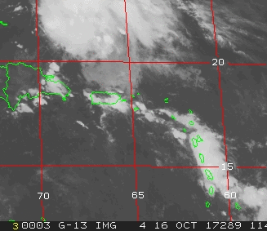
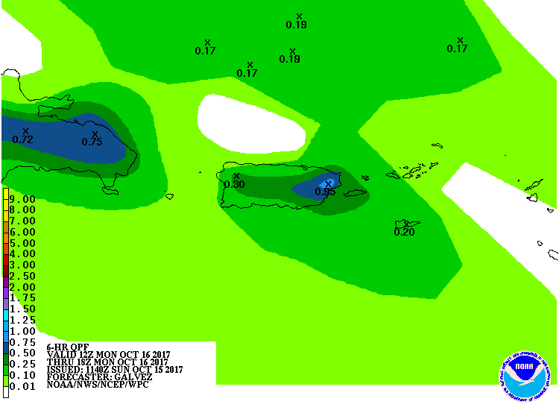
Support to Puerto Rico (San Juan WFO) since Hurricane María in September 2017
Example of forecast of rain event in Puerto Rico that produced 2 inches/24 hrs in San Juan (October 16, 2017)
Satellite IR4 animation: Oct 16 12-18Z

Slide 15
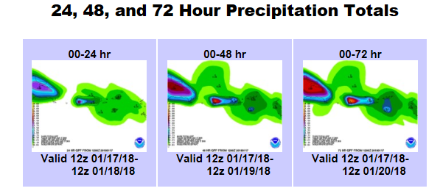
Hurricane Maria QPF Support Puerto Rico
Ongoing support

Slide 16
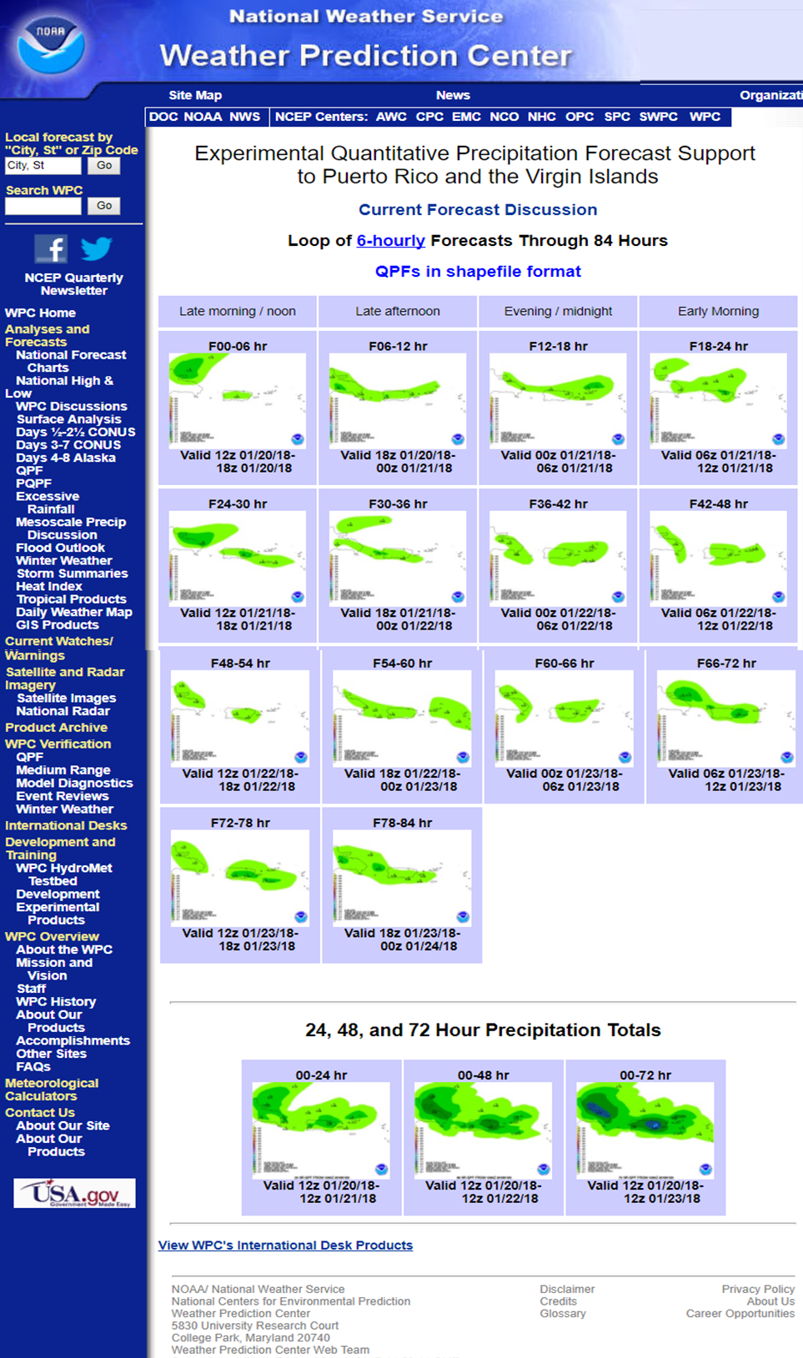
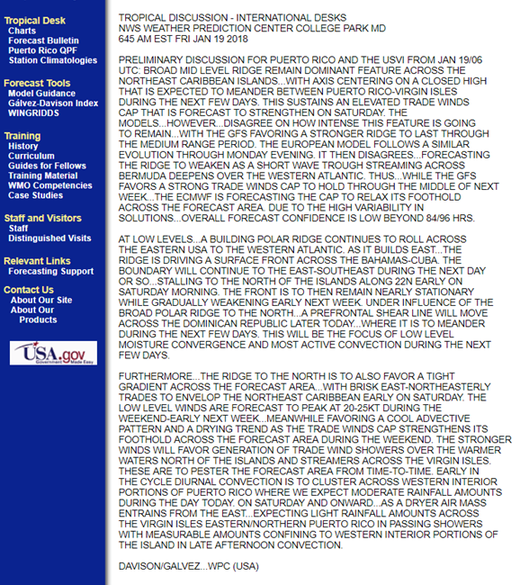
Daily Products (made available by 12 UTC)
6-, 24-, 48- and 72-hour QPF charts
in png and shapefile format
Forecast Discussion

Slide 17
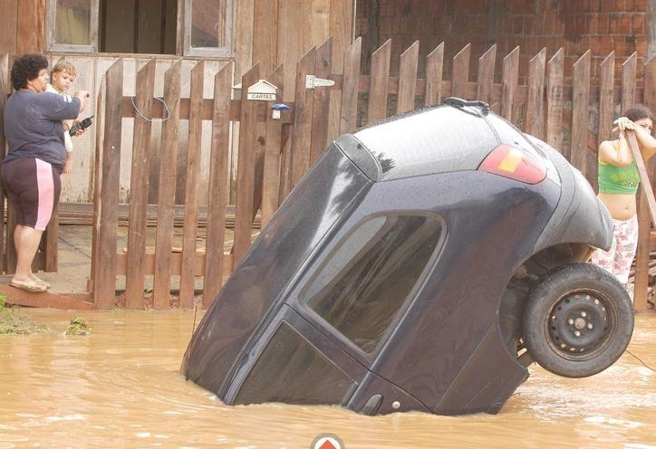
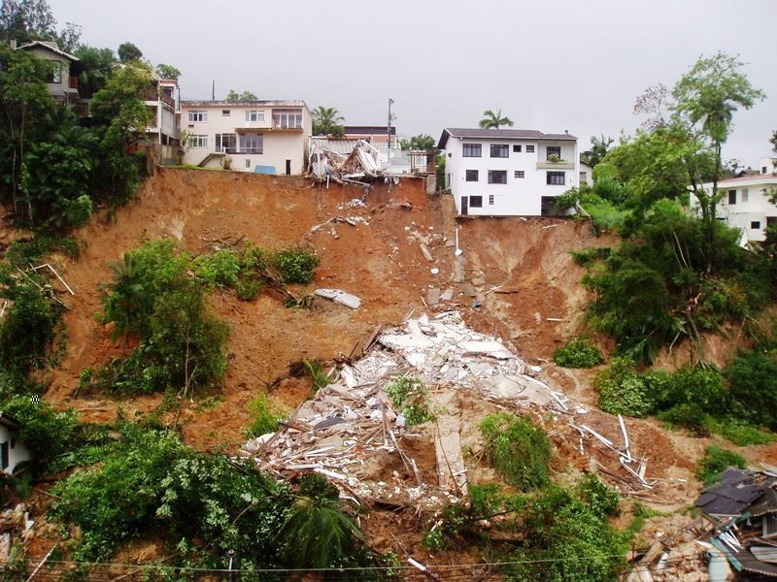
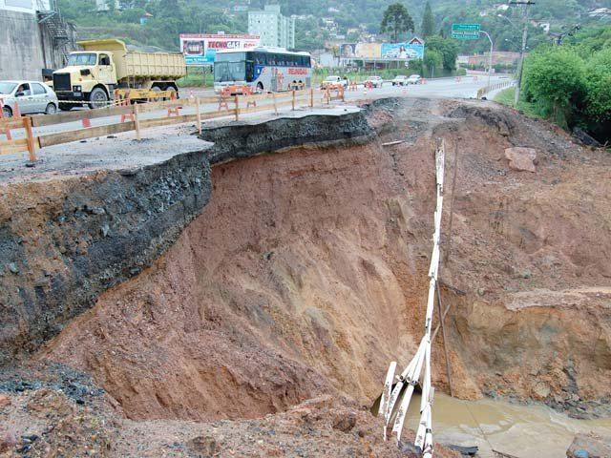
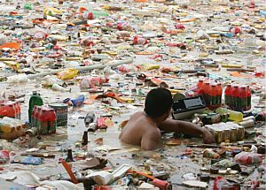
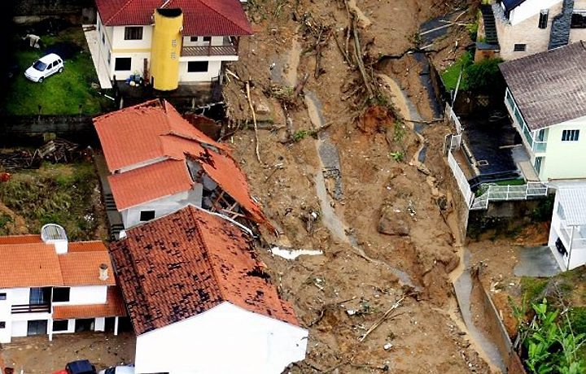
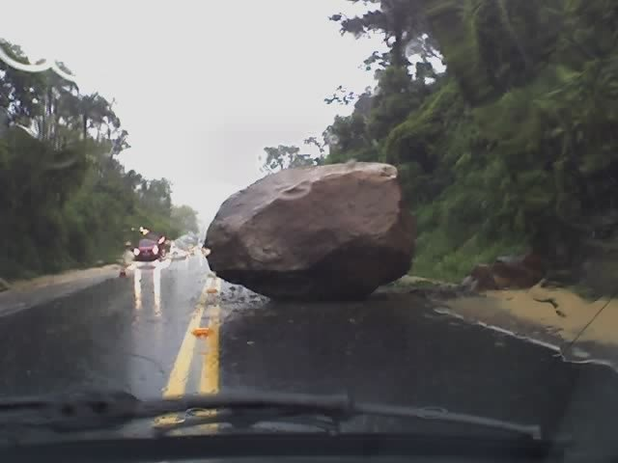
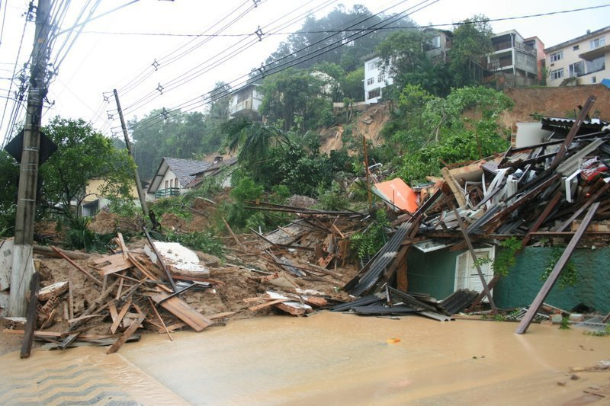
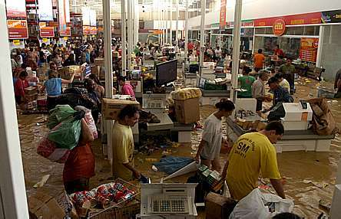
Subtropical Cyclone – Southern Brazil
39” (100 cm) in three days

Slide 18
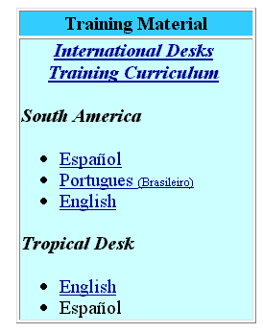
Training Material

Slide 19
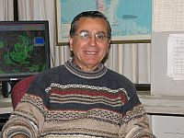
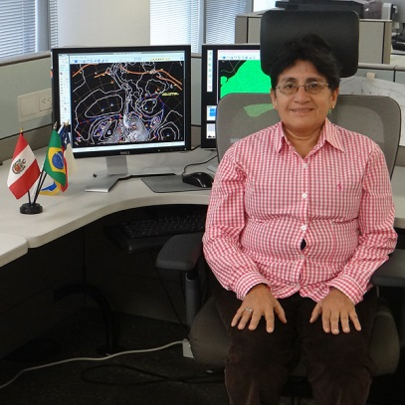
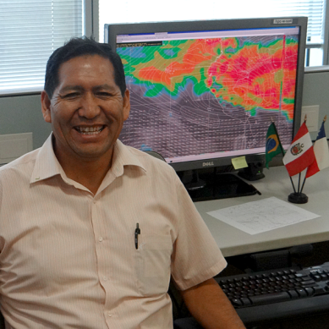
Visiting Instructor Program
Established in 2005
Provides a bridge between academia and operations
Invite meteorologists from the regional training centers and universities
Synopticians
Purpose
Evaluate our training program and provide recommendations
Get hands-on experience
Assist with product preparation/forecast bulletins
Instructors
Mrs. Kathy-Ann Caesar, CMIH Barbados
Prof. Osvaldo Gonzalez, Universidad de Valparaiso, Chile
Prof. Victoria Calle, Universidad Agraria, Peru
Prof. Franklin Unsihuay, Universidad Agraria, Peru

Slide 20
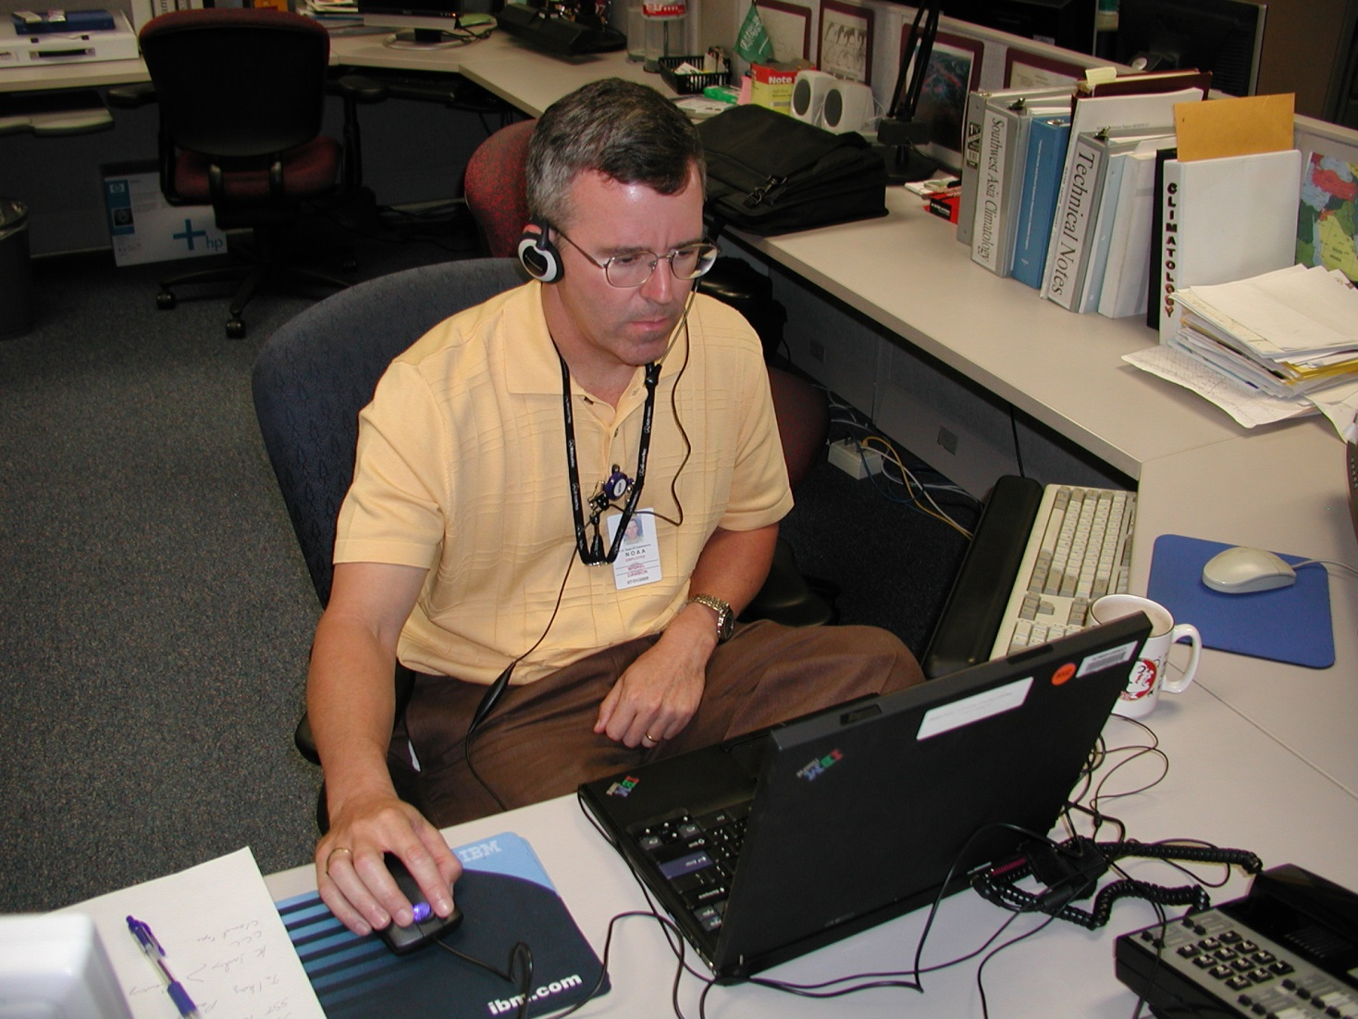
WMO Training Virtual Institute for Satellite Integration Training (VISIT) Lab

Slide 21
WMO Training Virtual Institute for Satellite Integration Training (VISIT) Lab
Monthly VISIT Session
Although tailored for RA-III/IV Members, it is open to all international participants
30-60 participants per session
RMTC (University of Costa Rica, CMIH Barbados, University Buenos Aires)
Hosted by CSU and NWS
One monthly session, in English and Spanish
Emphasis on Satellite Imagery Interpretation
Added global SST to monitor ENSO evolution
Added MJO Potential Anomaly
Evaluating satellite signatures to highlight ENSO transition
Remains a cost-effective way to conduct follow-on training to former fellows, and maintain interest/viability of the training program.

Slide 22
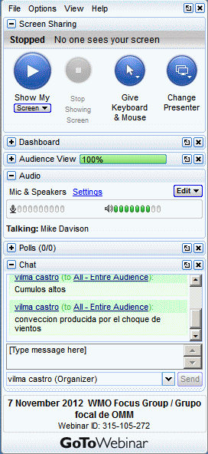
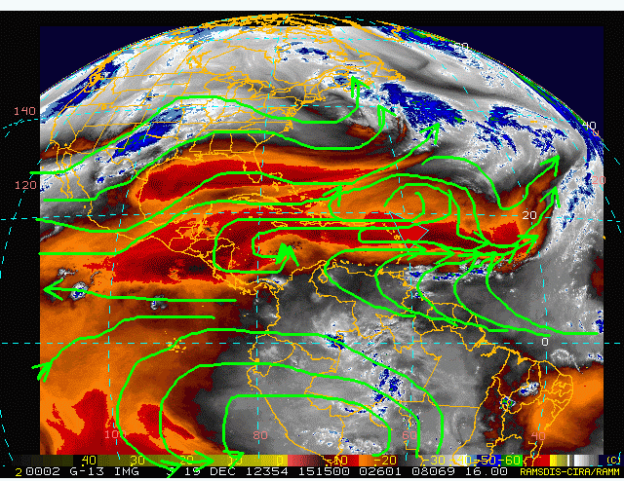
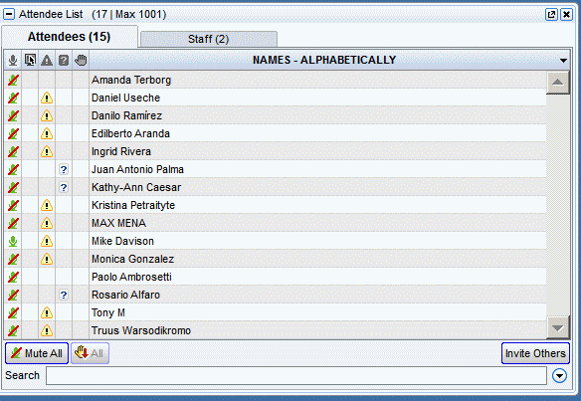
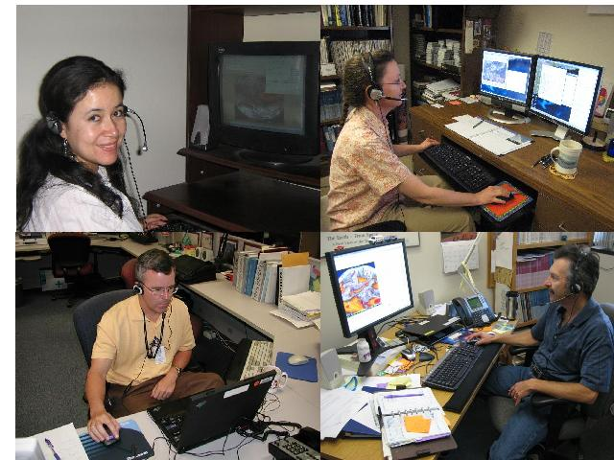
Bi-lingual:
English and Spanish

Slide 23
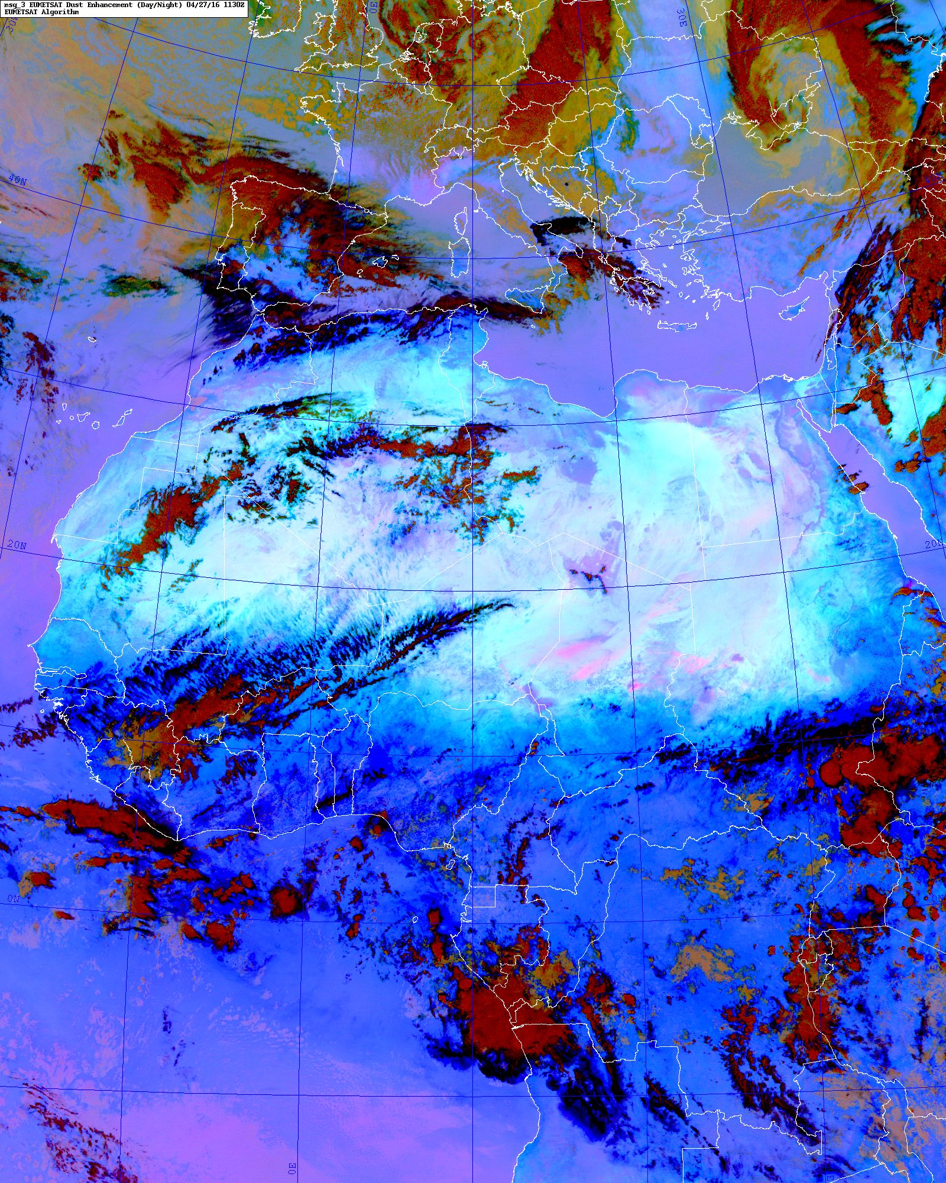
MSG-3 Dust Product
Early adopted product
Monitoring environmental conditions and its impact on:
Tropical Cyclones
Wind Surges
Squally weather

Slide 24
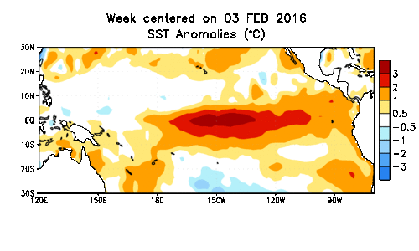
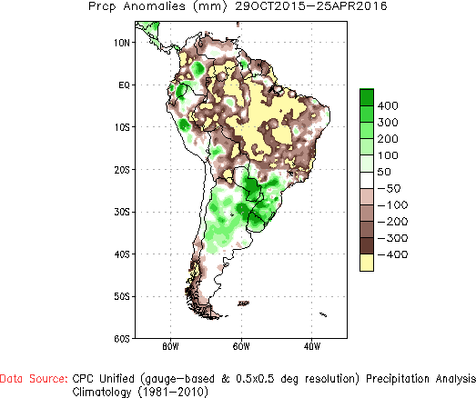
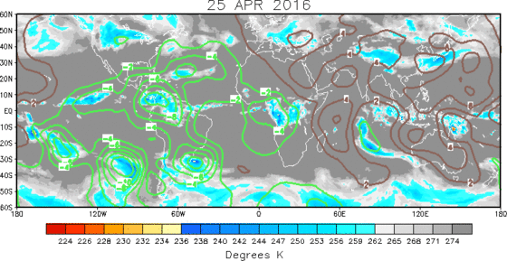
Climate Monitoring
ENSO – MJO
South American Monsoon

Slide 25
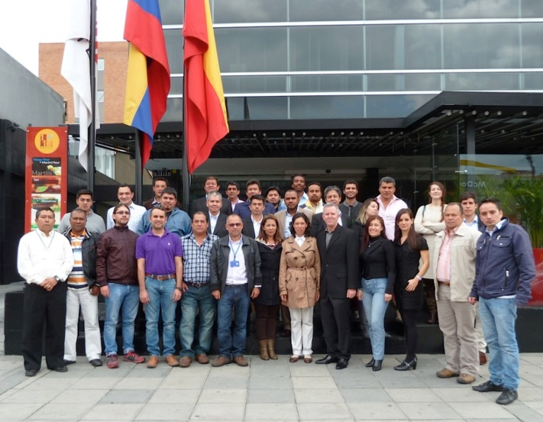
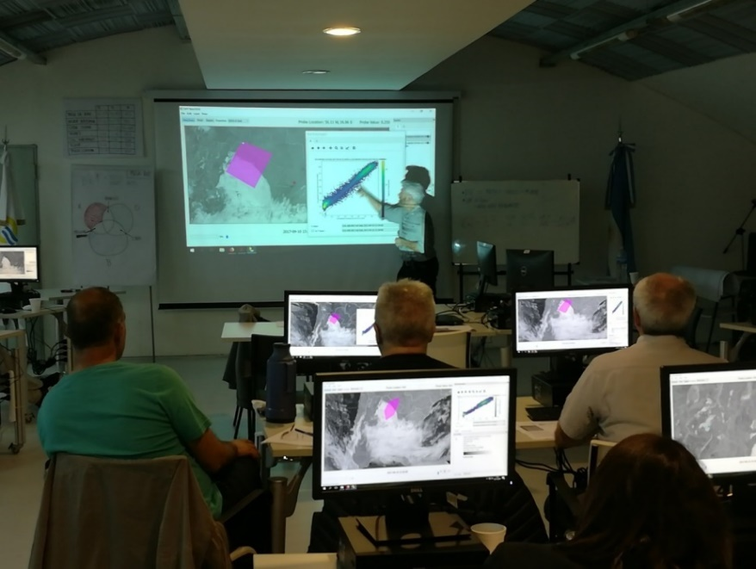
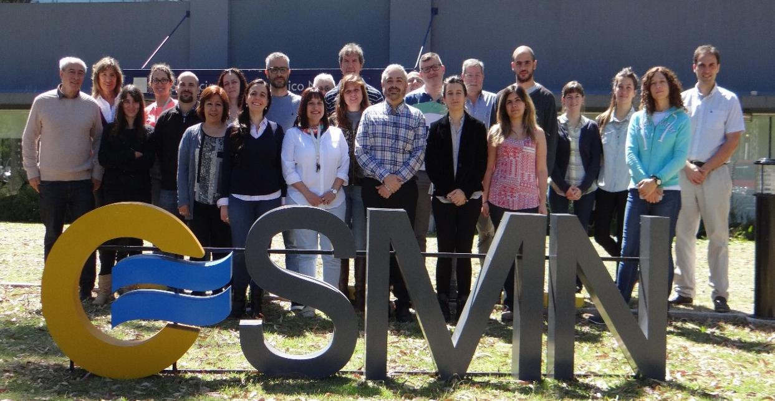
On-Site/In Country Training
Colombia, 2012
Argentina, 2017
Argentina, 2017

Slide 26
Users
National Users
Weather Service Forecast Offices and FAA Centers
Spanish Speaking Media
Department of Agriculture
United States Air Force
Public
International Users
Regional/National Meteorological Services
International Media
Marine
Public

Slide 27
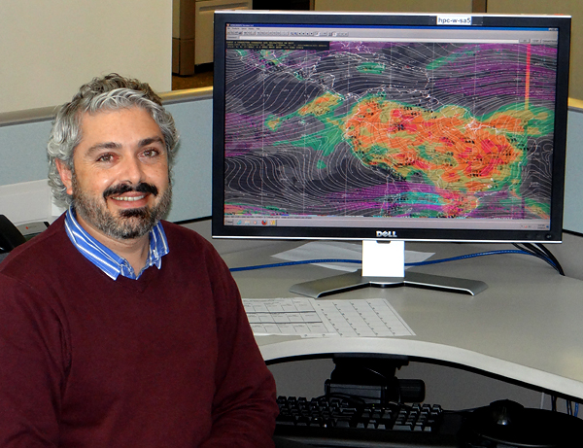
Applied Research since 2012
Dr. Jose M. Galvez

Slide 28
Applied Research, since 2012
R2O
Development of research to support training and operations
Example: Galvez-Davison Index for Tropical Convection (2013)
End of Course Project
During periods, fellows are required to conduct an end of tour research project to meet competencies standards and certification.
Also serves to apply learned concepts, document case studies, and acquire experience presenting in audiences.
ENSO
WPC assists the CPC with elaboration of long term guidance for other regions
Impact across the Caribbean Basin
Impact over South America

Slide 29
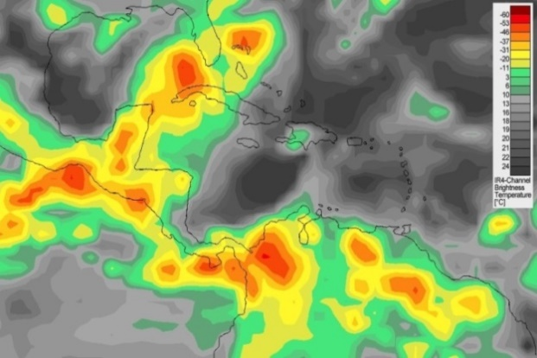
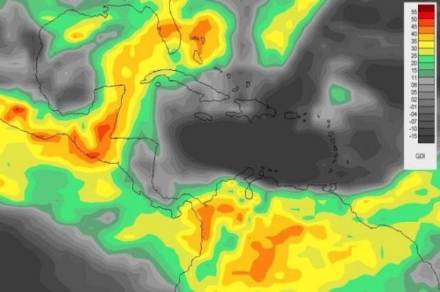
R2O Galvez-Davison Index for Tropical Convection
The GDI
Cold Cloud Tops
Is the first index developed in the last 50 years specifically to detect different regimes of tropical convection, with emphasis on trade wind regimes.
It’s a thermodynamic index that focuses on diagnosing column convective instability remarkably.
Developed at the WPC International Desks during 2013. Now used all over the world.
GDI

Slide 30
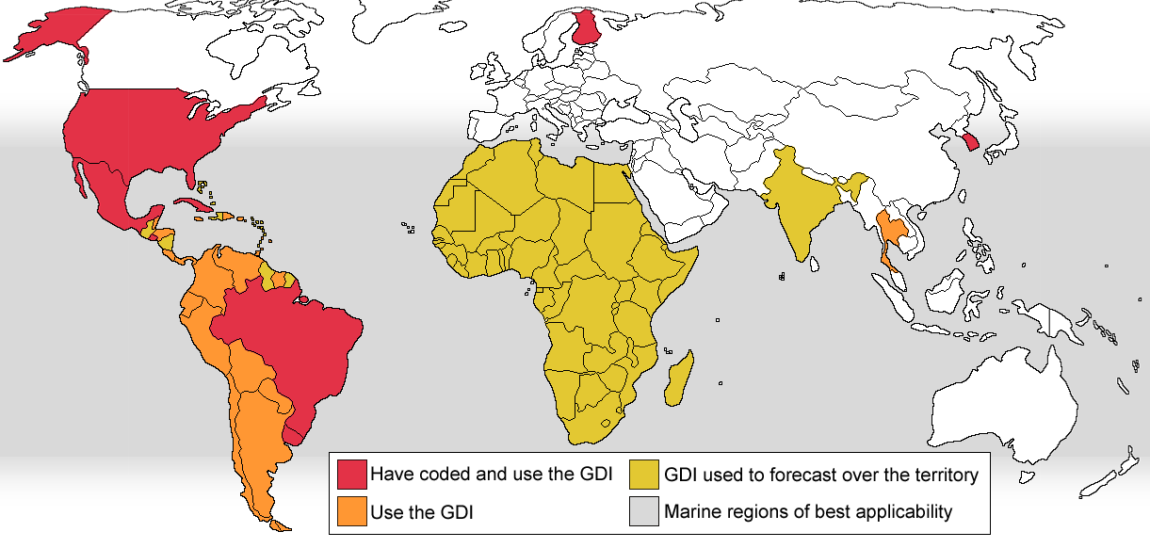
International use of the GDI (2018)
WPC International Desks, 2018
Incorporation into computing systems
Local Use
Remote Use
US Weather Prediction Center
US Aviation Weather Center
Mexico NWS
El Salvador NWS
Uruguay NWS
South Korea NWS
Finland included in developed software
Brazil (FUNCEME)
Most American NWS’s
South Korea
Thailand (evaluation)
CPC African Desk (for Africa)
Earthnetworks.com (for India)
WPC Desks (for the Americas)

Slide 31
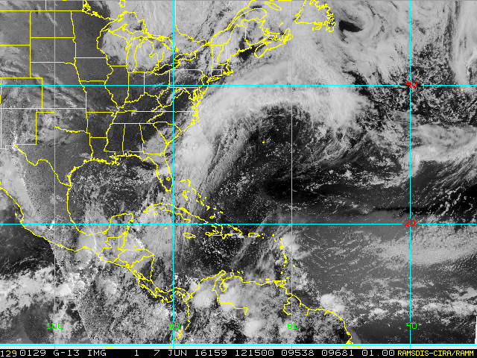
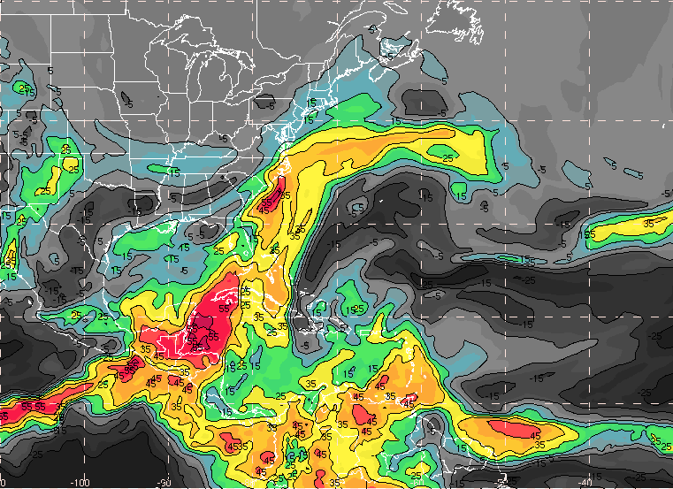
Example over North America and the Caribbean
31

Slide 32
Physical processes behind the GDI
Trade wind regime convection and rainfall mostly responds to:
Mid-level stability
Trade wind inversions and dry air over them
Column availability of heat and moisture
Notes:
First we have the processes that matter in the Caribbean Basin.
Then we have their reflection in model variables.
Finally a cross section showing the interaction between these processes and their signature in convection.
Explain processes in the Caribbean that matter.
-In the Caribbean Basin, as in most areas within the Tropics, convection prefers to develop in regions where the availability of heat and moisture in the column is large. A good variable This can be summarized by equivalent potential temperature
32

Slide 33
GDI vs other indices
r² GDI – r² Traditional Index
GDI correlates better (r²) to cold clouds than the traditional indices evaluated.
GDI - K
GDI - CAPE
Red areas
GDI functions better than the other index
GDI – T.Totals
GDI – Lifted

Slide 34
Real time GDI data
GDI Website
http://www.wpc.ncep.noaa.gov/international/gdi/
GDI calculated on current GFS output.
Entire world tropics and subtropics covered via 9 domains

Slide 35
Real time GDI data
GDI Website
http://www.wpc.ncep.noaa.gov/international/gdi/
GDI calculated on current GFS output.
Entire world tropics and subtropics covered via 9 domains

Slide 36
Real time GDI data
Asia-Maritime Continent
Africa
Pacific

Slide 37
GDI in the United States
Works best during the warm season, especially in the Southern and Eastern USA (subtropical air masses).
In the US Southwest, works for the Summer Monsoon. Summer thermal low may cause overestimation.
Works great for subtropical moisture plumes/atmospheric rivers along the West Coast.

Slide 38
How is a forecast constructed?
Many models are considered
GFS
GFS Ensemble
ECMWF
UKMET
NAM
WRF-High Resolution domains
Multi-model ensemble (thanks to Keith Brill)
Critical fields: Flow, moisture and instability
(Mostly based on GFS and ECMWF)
850-250 Ave Winds → Steering of deep Cbs
FLOW
700 Winds → Steering of moderate convection
850 Winds → Low-level moisture convergence, sea breeze interactions, and steering of shallow convection.
MOISTURE
Precipitable Water
Vertical cross sections of theta-e and relative humidity.
INSTABILITY
GDI
OTHERS
Vertical shear, inversion strength and height, orographic interactions, etc.

Slide 39
Use of the GDI in QPF
QPF needs to consider moisture, stability but also dynamic forcing (winds).
Best use of the GDI is to combine it with winds.
Provides detail and confidence to the forecast.
GDI, 1000-850 hPa winds and convergence (black), 400-200 hPa winds and divergence (white) and 500-600 hPa vorticity (reds and blues).
Geocolor+Cirrus Channel (GOES-16)

Slide 40
Use of the GDI in QPF
EXAMPLE: COLOMBIA
Adiabatic
Comp
LLJ Shear / Div
LLJ Shear / Div
Conv
Conv
ITCZ
Conv
Conv
Cool
SSTs
In this example: large GDI values are considered
Less relevant in regions of:
More relevant in regions:
Enhanced shear (low-level jets)
Adiabatic compression and subsidence
Cool SSTs / shallow inversions
of enhanced low-level convergence.
where a synoptic feature is present.

Slide 41
Thank You!

