Slide 1
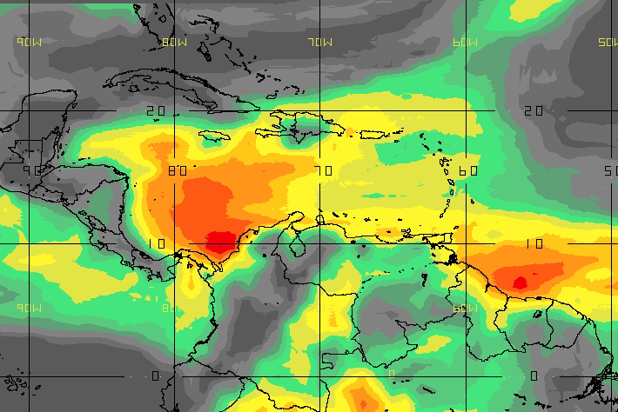
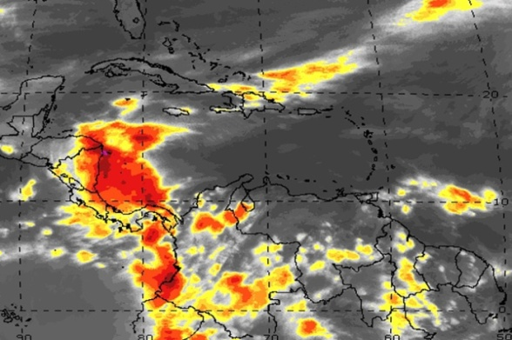
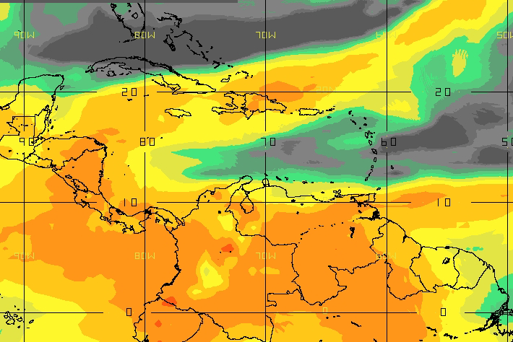
Stability Indices Michel Davison and José Gálvez
E.g.
CAPE
IR4 Sat
K
?
?
?
?
?
?
?
?
?
?
?
?
?
?
?
?
?
?
?
?
?

Slide 2
Why are they important?
Stability indices can help to determine the potential for convection, its type and severity.
Shallow Deep
1/57

Slide 3
Column Stability
Objective evaluation of atmospheric stability is one of the hardest challenges for the tropical forecaster.
Traditional Indices are only designed keeping mid-latitudes in mind (they not always work for the tropics).
It is essential to be able to distinguish between periods with the potential for
Shallow convection
Deep convection
2/57
Notes:
Para determinar el potencial de convección es importante determinar la estabilidad de la columna de una manera objetiva.

Slide 4
Traditional Indices
Parcel Method
Lifted Index (LI)
Showalter Stability Index (SSI)
Total Totals (TT)
K Index (K)
Thermodynamic Method
CAPE
3/57

Slide 5
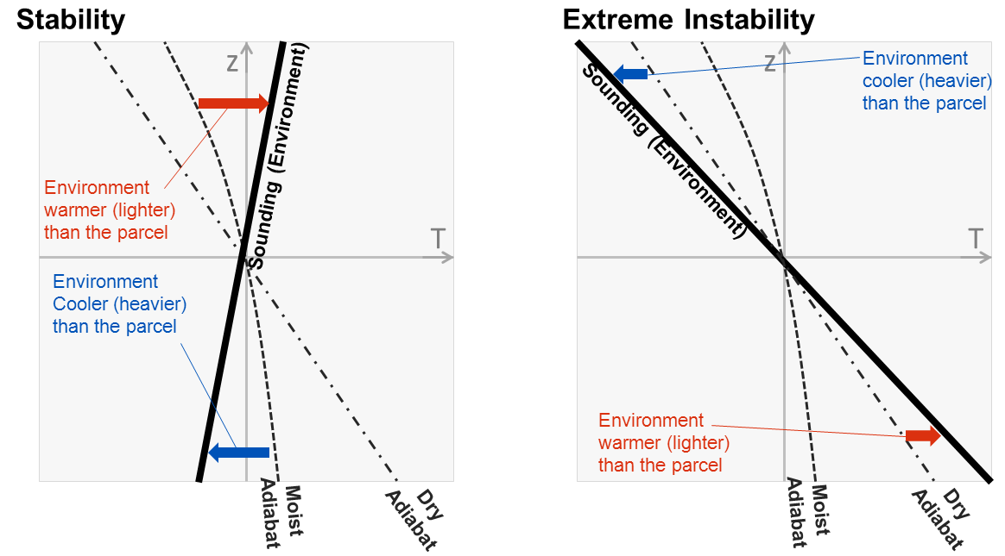
Parcel Method
To determine instability, a parcel of air is displaced in the vertical assuming there is no interaction with the environment.
4/57
Notes:
A method of testing for instability in which a displacement is made from a steady state under the assumption that only the parcel or parcels displaced are affected, the environment remaining unchanged.

Slide 6
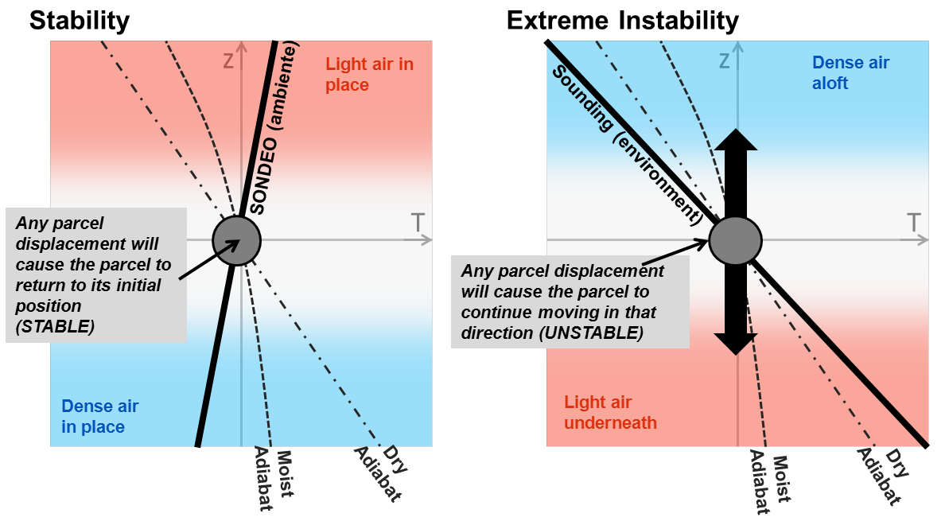
Parcel Method
To determine instability, a parcel of air is displaced in the vertical assuming there is no interaction with the environment.
5/57
Notes:
A method of testing for instability in which a displacement is made from a steady state under the assumption that only the parcel or parcels displaced are affected, the environment remaining unchanged.

Slide 7
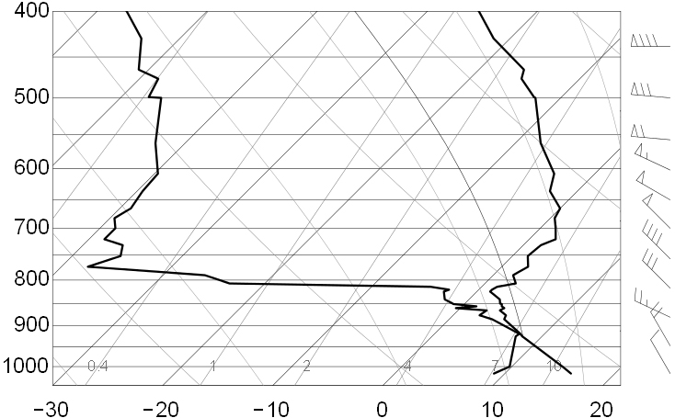
Parcel Method
Shallow convection example (Key West, FL, 04-Mar-2013 00z)
-Neutral/unstable below 800 hPa
-Very stable from 800 to700 hPa (inversion or “lid”)
-Stable aloft
Stable (parcel needs too much forcing to either ascend or descend)
Extremely stable, subsidence inversion (parcel will not ascend or descend)
Unstable/neutral: parcel can easily ascend or descend (convection favored)
6/57
Notes:
A method of testing for instability in which a displacement is made from a steady state under the assumption that only the parcel or parcels displaced are affected, the environment remaining unchanged.

Slide 8
Lifted Index (LI)
LI = 500 hPa Temperature (Ambient) – 500 hPa Parcel Temperature (Temperature that the parcel would have if ascending from the boundary layer)
LI = T500 – TPARCEL_500
TPARCEL_500
T500
7/57

Slide 9
Lifted Index (LI)
The more negative the more unstable.
Limiting Factors:
Considers only two levels.
Aplicable into barotropic air masses in the warm side of upper troughs.
LI = T500 – TPARCEL_500
_
+
NEGATIVE: UNSTABLE
POSITIVE: STABLE
8/57

Slide 10
LI Values
Positive: Stable
0 to -4: Marginally Unstable
-4 to -6: Unstable
< -8: Extreme Instability
9/57

Slide 11
Showalter Stability Index (SSI)
Similar to LI but ascending from 850hPa:
SSI = 500 hPa Temperature (Ambient)
– 500 hPa Parcel Temperature, ascending
from 850 hPa
Functions well when there is a cold layer present under 850 hPa.
Does not work when cold layer extends over 850 hPa.
Does not consider effects of diurnal heating.
Does not work if station is located over 850 hPa.
10/57
Notes:
a stability index used to determine thunderstorm potential. The SWI is calculated by lifting an air parcel adiabatically from 850 mb to 500 mb. The algebraic difference between the air parcel and the environmental temperature at 500 mb represents the SWI. It is especially useful when you have a shallow cool airmass below 850 mb concealing greater convective potential aloft. However, the SWI will underestimate the convective potential for cool layers extending above 850 mb. It also does not take in account diurnal heating or moisture below 850 mb. As a result, one must be very careful when using this index.

Slide 12
SSI Values
Positive: Stable
0 a -4: Marginally Unstable
-4 a -6: Unstable
Less than -8: Inestabilidad Extrema
11/57

Slide 13
SSI - LI Intercomparison
Both consider only two levels
500 hPa
Level where parcel originates (BL top or 850 hPa)
LI >0, SSI > 0 → Very stable layer
LI < 0, SSI > 0 → Unstable boundary layer, possible inversion aloft.
LI > 0, SSI < 0 →Stable boundary layer, but atmosphere tends to become more unstable with height.
LI < 0, SSI < 0 = Deep unstable layer
12/57
Notes:
Comparison to LI: If the LI is negative while the SI is positive (such as shown in sounding below), that is an indication that the PBL is unstable while the region just above the PBL is stable (some capping exists). If the LI is positive while the SI is negative, that is an indication that the PBL is stable but the lower troposphere becomes unstable with height. This can occur in cases where shallow polar air is in the PBL while there is an unstable air mass aloft. If the LI and SI are both negative it often indicates a deep layer of unstable air in the lower troposphere is in place. If the LI and SI are both positive it often indicates a deep layer of stable air in the lower troposphere is in place.

Slide 14
Total Totals
Calculated with 500 hPa Temperatures and both Temperature and Dewpoint at 850 hPa.
TT = (T850 + T_{d}850) - (2*T500)
STABLE (Low Values)
UNSTABLE (High Values)
Lower values when mid-troposphere is warm and low troposphere cool and dry.
Higher values when mid-troposphere is cool and low levels are warm and moist.
WARM
COOL
500
500
850
850
DRY
COOL
MOIST
WARM
13/57
Notes:
http://www.meted.ucar.edu/mesoprim/skewt/tt.htm
TT is a widely-used severe weather index that is very easy to compute. However, it is limited in that it uses data from only two mandatory levels (850 and 500 hPa) and thus does not account for intervening inversions or moist or dry layers that may occur below or between these levels. In addition, it does not work for areas in the western Great Plains or the Rocky Mountains, where 850 hPa is near the surface or below ground. Last, like several other severe weather indexes, it does not take into account wind shear, which is a critical factor in many severe convective environments.

Slide 15
Total Totals
PROS
Easy to calculate.
Works well over mid-latitudes and some times over the tropics.
LIMITATIONS
Considers only two levels.
Does not work over elevated terrain (Psfc>850 hPa).
Problems when inversions are present between these two levels.
Too high over post-frontal air masses.
14/57
Notes:
http://www.meted.ucar.edu/mesoprim/skewt/tt.htm
TT is a widely-used severe weather index that is very easy to compute. However, it is limited in that it uses data from only two mandatory levels (850 and 500 hPa) and thus does not account for intervening inversions or moist or dry layers that may occur below or between these levels. In addition, it does not work for areas in the western Great Plains or the Rocky Mountains, where 850 hPa is near the surface or below ground. Last, like several other severe weather indexes, it does not take into account wind shear, which is a critical factor in many severe convective environments.

Slide 16
K Index
K = (T850 – T500) + [ Td850 – (T700-Td700) ]
Vertical temperature
gradient
(stability)
Water vapor content between 850 and 700 hPa
(available water)
Since the K-index considers available water en 850 y 700 hPa, tends to function well in the tropics.
Good for maritime tropical air masses.
CIMH: K-index values that favor deep convection
Northern Caribbean > 24
Southern Caribbean/South America > 30
15/57
Notes:
The KI is a combination of the Vertical Totals (VT) and lower tropospheric moisture characteristics. The VT is the temperature difference between 850 and 500 mb while the moisture parameters are the 850 mb dewpoint and 700 mb dewpoint depression. KI = (T850 - T500) + (Td850 - Tdd700) The equation above for the KI is stating (850 mb temperature minus 500 mb temperature) plus (850 mb dewpoint minus 700 mb dewpoint depression)

Slide 17
Valores del K (Mid-latitudes)
Once dewpoints at 850 hPa are high and Dewpoint depression at 700 is low, K-index values are high indicating the presence of a deep warm and moist airmass.
15 – 25 = Low Potential for Convection
26 – 39 = Moderate Potential for Convection
+40 = High Potential for Convection
16/57

Slide 18
Limiting factors for the K-Index
Does not see mid-level inversions.
Does not help to determine storm severity on its own.
When 850-500 temperature differences are large, the K index can generate values that are too high and unrealistic.
Not applicable over mountainous terrain, only over flat areas of low elevations.
17/57

Slide 19
Thermodynamic Method
18/57

Slide 20
CAPE
Represents the potential energy of parcels that ascend over the Level of Free Convection (LFC).
Convective potential is higher when the LFC is lower.
It is a good way to evaluate the potential for severe weather.
Units in Joules per kilogram (Energy per unit mass)
Represents the available energy required to force a parcel to ascend
Also represents the amount of work a parcep
exerts on its environment.
19/57
Notes:
http://www.tornadochaser.net/cape.html

Slide 21
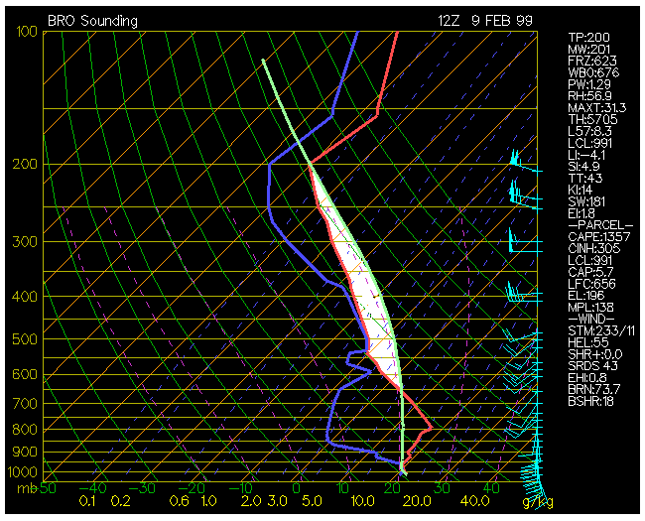
Positive and Negative Areas
20/57
Notes:
El área positiva en la curva termodinámica nos muestra el potencial de una parcela de aire a ascender, mientras mayor esta área, y mientras mas baja se encuentre, mejor potencial.

Slide 22
Convective Inhibitors (CINS/CINH)
Negative part of the sonde is the CINH:
High values of CINH imply convection suppression
Too low CINH facilitates energy release and the development of deep convection.
CINH values that are in the middle suggest that convection depends on the CAPE.
Low CAPE → Convection inhibited
Large CAPE → Delayed convection with explosive potential (as a pressure cooker)
21/57

Slide 23
CAPE Values (in mid latitudes)
CAPE
Convective Potential
0
Stable
0-1000
Marginally Unstable
1000-2500
Moderately Unstable
2500-3500
Very Unstable
3500+
Extremely Unstable
22/57

Slide 24
CAPE Limiting Factors
CINH needs to be considered
CINH values are not directly proportional to CAPE values
Tropical air masses sometimes develop high values of CAPE and no deep convection develops. Example:
CAPE
Imagen de satélite IR4
23/57

Slide 25
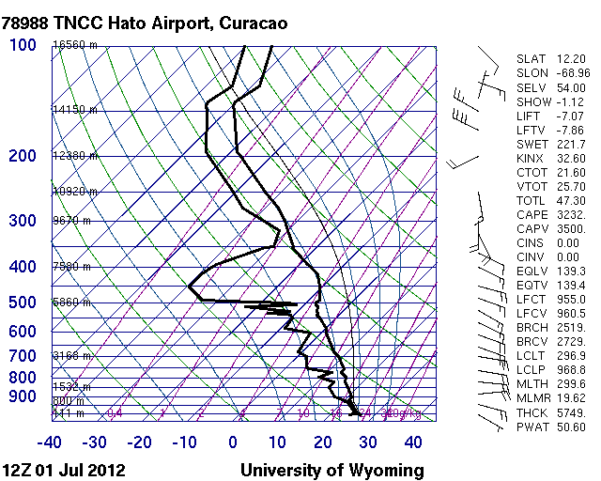
Sonde from Curacao
24/57

Slide 26
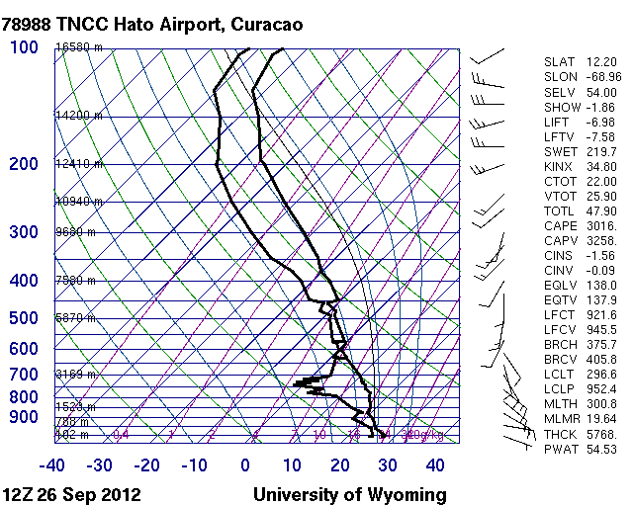
Sonde from Curacao
25/57

Slide 27
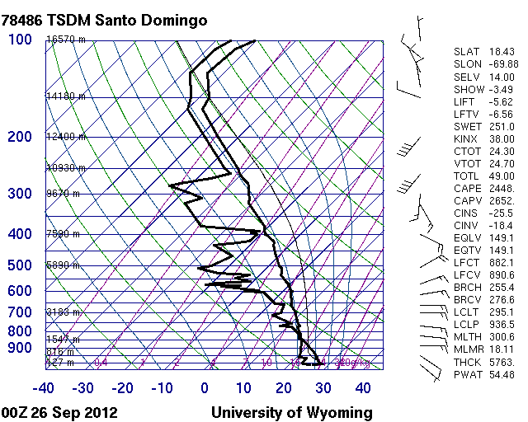
Sonde from Santo Domingo
26/57

Slide 28
Problems in the Tropics
Tropical atmosphere tends to become more unstable AFTER (not before) deep convection:
-Effects of latent heat release and column moistening.
Parcel method works better only if there is cold air at mid-levels
TUTT present
Tropical troposphere is very deep. This tends to generate very high values of CAPE that are not always conducive for deep convection.
27/57

Slide 29
Possible Solution
In the tropics…
We need to consider entire column
Vertical distribution of moisture is essential.
Vertical temperature gradients are very subtle.
Meso-synoptic forcing in the tropics is too subtle..
Forcing depends much more on radiative heating, associated breezes and orographic effects.
Tropical convection depends much more on convective instability.
Column thermodynamics are essential.
28/57

Slide 30
Column Convective Instability
Can be evaluated using vertical profiles of equivalent potential temperature (THTE).
This combines effects of temperature and moisture.
Column is considered convectively unstable when equivalent potential temperature (THTE) decreases with height. This represents warm and moist (light) air sitting under cool and dry (dense) air.
If THTE increases with height, where warm and moist air sits over cool and dense air, the column is convectively stable.
29/57

Slide 31
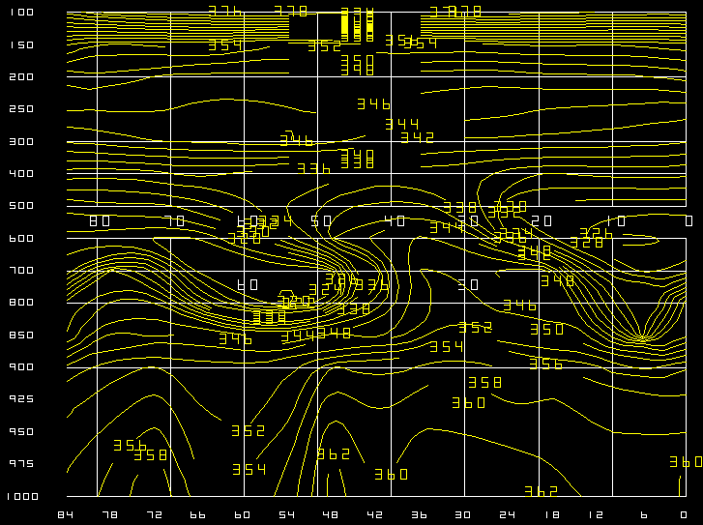
Equivalent Potential Temperature Convective Instability
Inversion
Deep instability
30/57

Slide 32
Convective Instability
Calculating it: We can calculate the algebraic difference between two levels. This would capture the tendency in the atmosphere and would allow us to rapidly find where the column is convectively unstable in a horizontal plane (map).
→ Convective Instability ~ THTE 700 – THTE 850
Dif > 0, Stable
Dif < 0, Unstable
31/57

Slide 33
THTE Difference between two levels
32/57

Slide 34
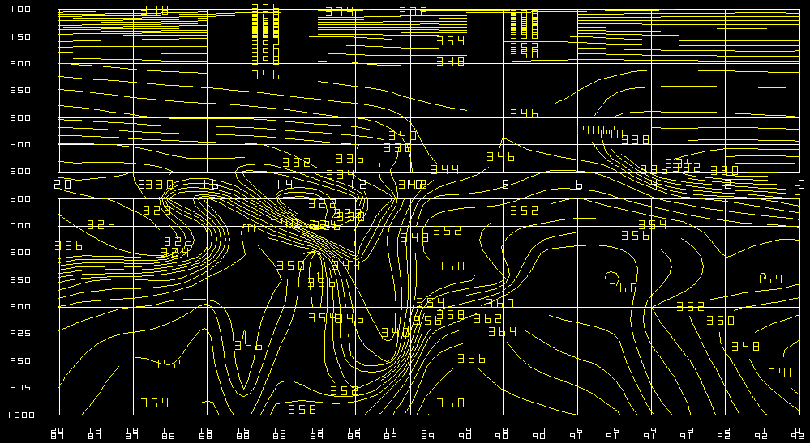
Differences in a vertical cross section
Honduras
ITCZ
33/57

Slide 35
Problems with this method
Does not consider column thickness.
Same limitations as parcel method.
Does not distinguish between thermal cores and inversions:
Problem in the tropics: SUBSIDENCE INVERSIONS. The decrease of moisture with height overwhelms the temperature increase. This leads to a sharp decrease in THTE (instead of an increase).
→ So sharp decrease in THTE in the tropics can be
associated also to extreme stability.
34/57

Slide 36
Equivalent Potential Temperature
Δ = -8
Δ = -21
Δ = -6
35/57

Slide 37
The Galvez-Davison Index (GDI)
for convective instability
in the Caribbean Basin
José Manuel Gálvez
Mike Davison
36/57

Slide 38
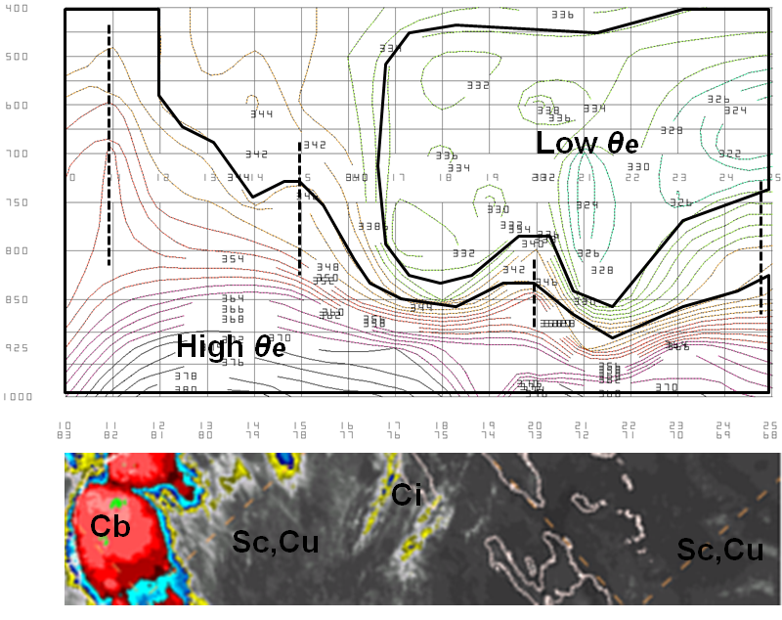
Basis
Z
Studies
(2) Forecasting experience:
Mike Davison noted a clear relationship between columns
of high θe and convection
“Thermal core” = Column of high θe
= region of high moisture content and heat with respect to the environment.
X
What else matters in the Caribbean?
-Trade wind inversion is essential! Often (not always) determines depth of convection. Aside from high stability, dry air entrainment important.
-Mid-level temperatures. TUTTs can enhance convection by cooling the mid-levels and destabilizing mid-upper troposphere. Warm mid-levels near ridges enhance stability and inhibit convection.
37/57

Slide 39
What to do?
Try to develop a new index that works in the Caribbean!
Methodology
Identify key processes that lead to different types of convection across region.
Identify the signature of these processes
on model variables.
Combine relevant variables using arithmetic
expressions to come up with one number
that summarizes variable interactions.
38/57

Slide 40
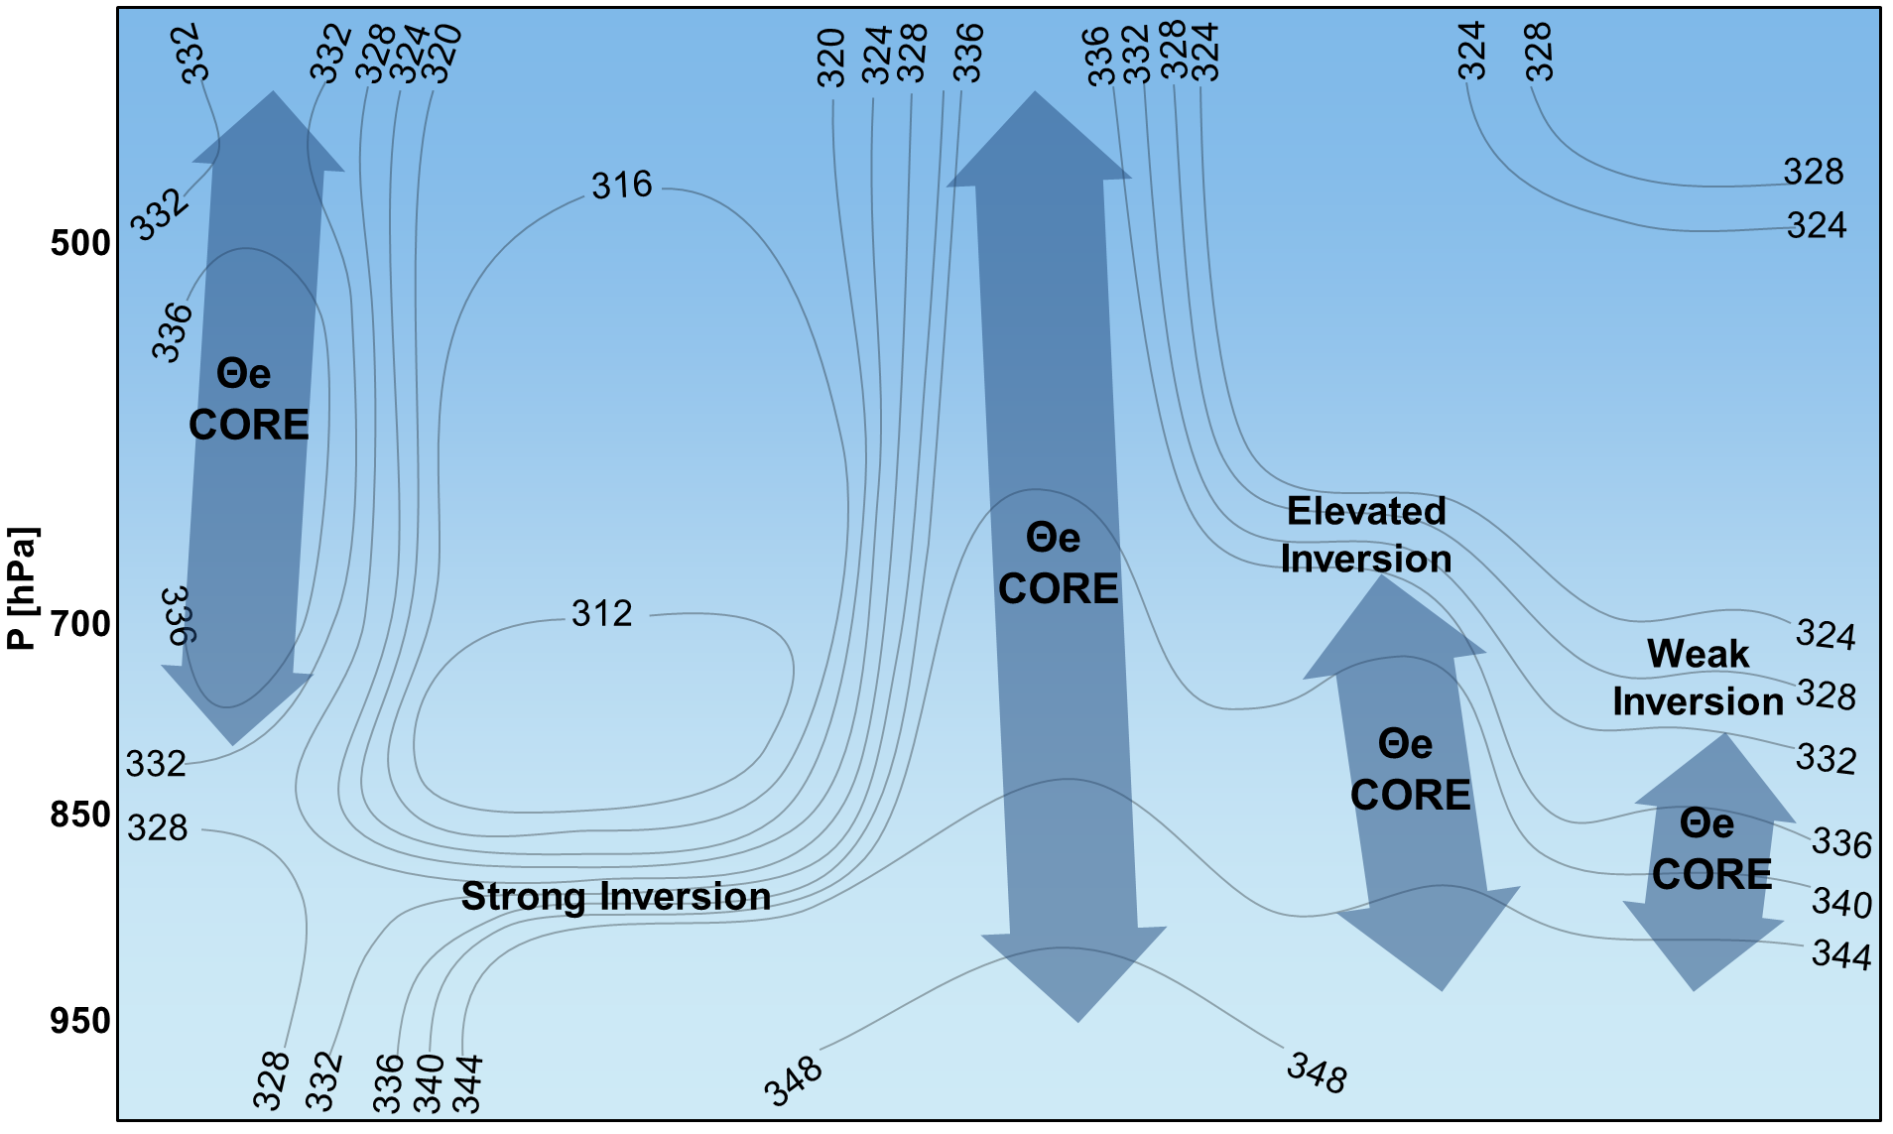
Conceptual Model of signature of different atmospheric processes on the θe Field
Trade wind inversion: stable layer and dry air entrainment
Shallow convection can also produce heavy rain
39/57
Notes:
-TC = Thermal Core
-At low levels, moisture dominates on

Slide 41
Algorithm
Galvez-
Davison
Index
(GDI)
Inversion
Index
(II)
Optional
Corrections
(OC)
Thermal
Index
(TI)
=
+
+
θe core factor (TCF)
Summarizes vertical structure of heat and water vapor using θe at 6 levels to assess the potential for convection.
Inversion factor (IF)
Convection inhibition due to weak lapse rate between 950hPa and 700hPa, often associated with trade wind inversion.
Structure enhancement
Decreases GDI near the equatorial troughs, where TCF values tend to be excessive.
(Enhancement Factor)
(Inhibition Factor)
Mid-level warming factor (MWF)
Infers stabilizing/destabilizing effect ridges/troughs using 500hPa temperatures. Warmer mid-levels imply more stability and deep convection inhibition.
Orography
Decreases GDI over high terrain to reduce high values from fictitious interpolation.
Mostly to improve visualization of model output.
Drying factor (DF)
Convection inhibition due to evaporation of clouds that penetrate dry layer aloft, also associated with trade wind inversion.
(Inhibition Factor)
(Inhibition Factor)
40/57
Notes:
Alpha in Kelvin
0.05 Kelvin^-2
3.5 Celsius^-1
10C

Slide 42
Part 1: Base calculations
INPUT
INPUT
VARIABLES
P(hPa)
500
●T,r
LAYER C
700
●T,r
LAYER B
850
●T,r
950
●T,r
LAYER A
41/57
Notes:
Alpha in Kelvin
0.05 Kelvin^-2
3.5 K/Celsius
10C

Slide 43
Part 1: Base calculations
Layer averages of potential temperature and mixing ratio
INPUT
VARIABLES
P(hPa)
500
●T,r
LAYER C
700
●T,r
LAYER B
850
●T,r
950
●T,r
LAYER A
42/57
Notes:
Alpha in Kelvin
0.05 Kelvin^-2
3.5 K/Celsius
10C

Slide 44
Part 2. Base calculations, EPT
Equivalent Potential Temperature (EPT) Proxys
Uses the formula compiled by Davies-Jones(2009).
Simplification: T_{LCL} replaced by T_{K850} since effect on final GDI is small.
CONSTANTS
α= -10 K (Adjustment)
INPUT
VARIABLES
P(hPa)
LAYER C
500
●θ_{C},r_{C},T_{K850}
700
LAYER B
●θ_{B},r_{B},T_{K850}
850
●θ_{A},r_{A},T_{K850}
950
LAYER A
43/57
Notes:
Alpha in Kelvin
0.05 Kelvin^-2
3.5 K/Celsius
10C

Slide 45
Part 2: Thermal Index
44/57
Notes:
Alpha in Kelvin
0.05 Kelvin^-2
3.5 K/Celsius
10C

Slide 46
Part 2: Inversion Index
45/57
Notes:
-2.5 in K
IF times K/C

Slide 47
Optional corrections ←terrain and high values near ITCZ/NET
Galvez-Davison
Index
(GDI)
Thermal
Index
(TI)
Inversion
Index
(II)
Optional
Corrections
(OC)
=
+
+
46/57
Notes:
Alpha in Kelvin
0.05 Kelvin^-2
3.5 Celsius^-1
10C

Slide 48
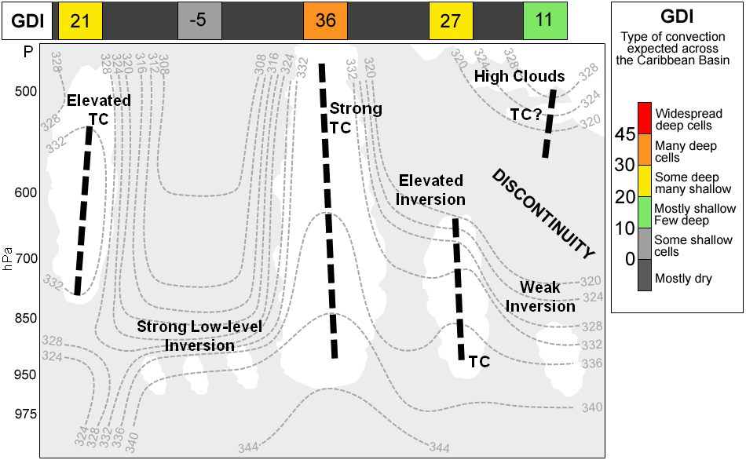
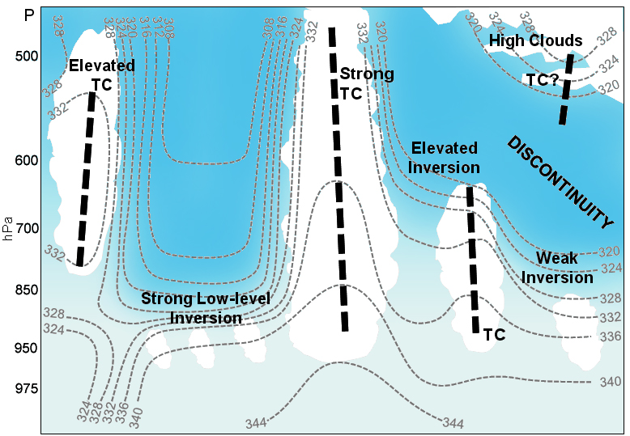
Example of GDI values for different processes
47/57

Slide 49
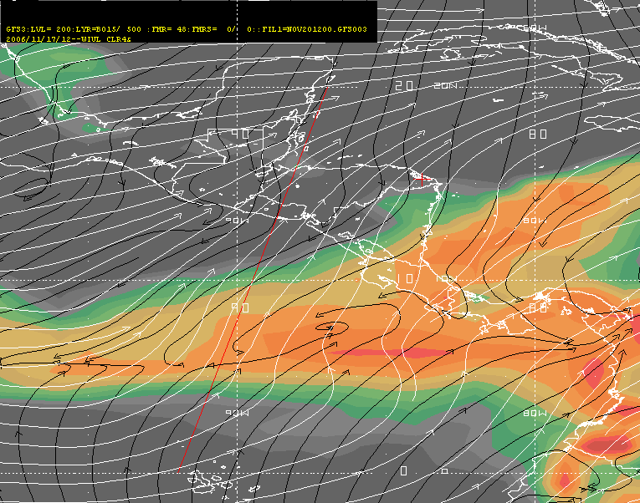
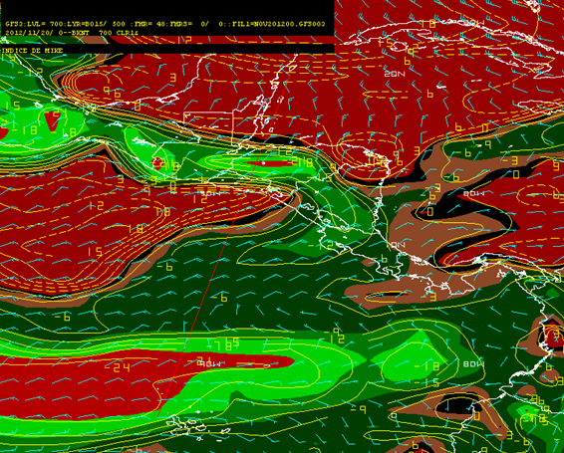
GDI
GDI vs
Two-levels
Two
Levels
Note better resolution of the GDI over Central America, where the direct difference between two levels suggested a higher potential for convection.
48/57

Slide 50
Index Validation
Comparison against other indices
Evaluation:
GDI capability to forecast the potential for moist convection regimes.
Compared against other indices:
-CAPE -K Index -Lifted Index -TOTAL TOTALS
Observations used (“true”) → Averages of cloud top temperatures from IR4 satellite data
Periods were sinchronized
The GDI worked better than the traditional indices, providing better detail about the areas for the potential of different convection regimes (shallow and deep)
49/47
Notes:
Need to define these indices

Slide 51
How do we evaluate?
Warm tops: little convection
Cool tops→ shallow convection and a few deep cells
Coldest tops → Deep convection
SAT
Temperature scale in Celsius
Indices
Low values in GDI, K, CAPE/50, TOTALS-30 less potential
Index scale
Expected result
Satellite
Index
50/57
Notes:
Need to define these indices

Slide 52
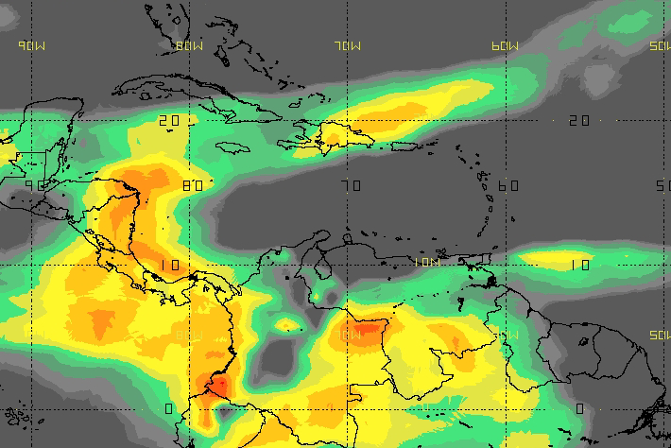
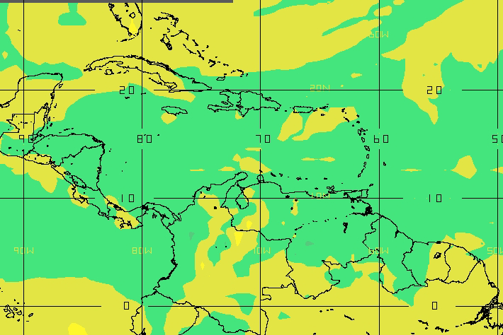
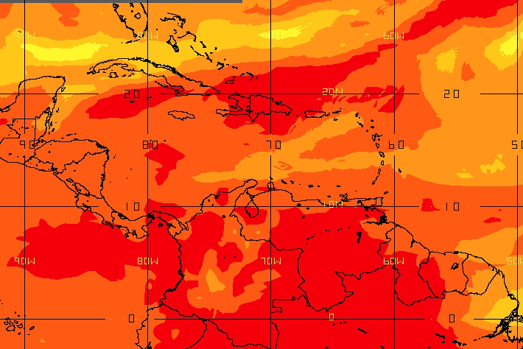
Example 1
Nov.4.2012
IR4 (observed)
GDI
Temperature Scale in C
CAPE/50
K
Intercomparison
Lifted+20
Totals
51/57
Notes:
GDI captures better areas of deep convection. Field more discrete than K. GDI did really well over
(1) Eastern Central America, (2) The Choco/western Colombia, (3) Atlantic ITCZ, (4) Cayman Islands, (5) Hispaniola into Atlantic.
+Northern Venezuela: GDI > K in suggesting limited chance for deep convection.
+GDI overcorrects over mountains?
+General problems across the Amazon with all indices. Hard to capture fine structure of convection.

Slide 53
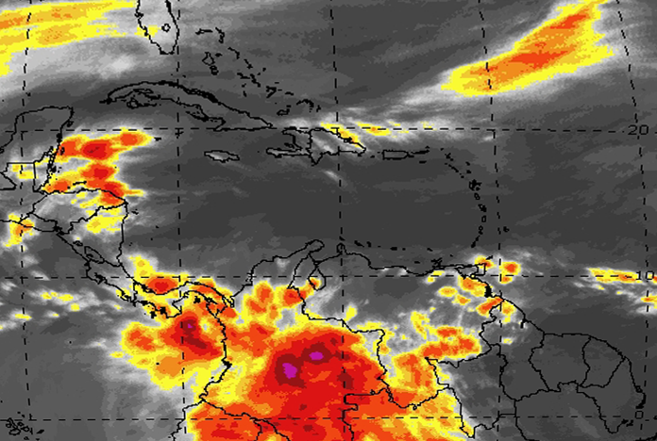
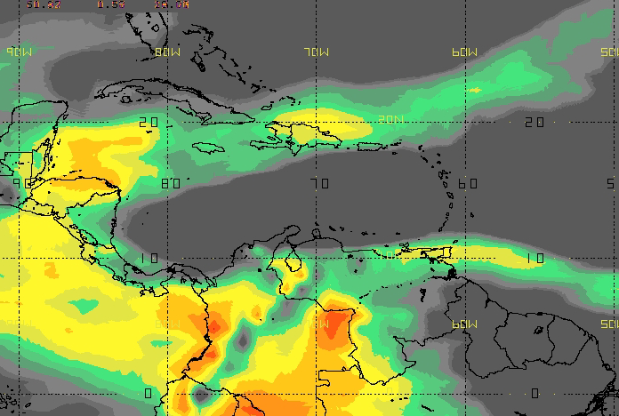
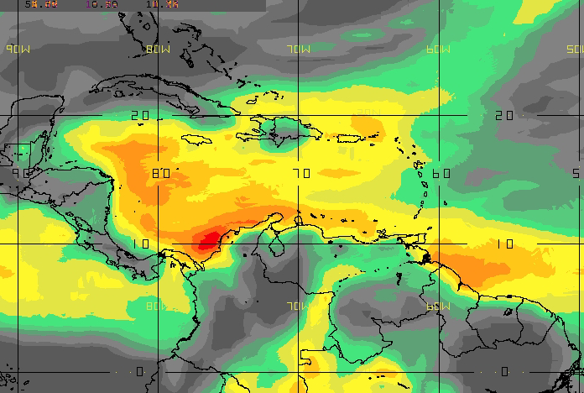
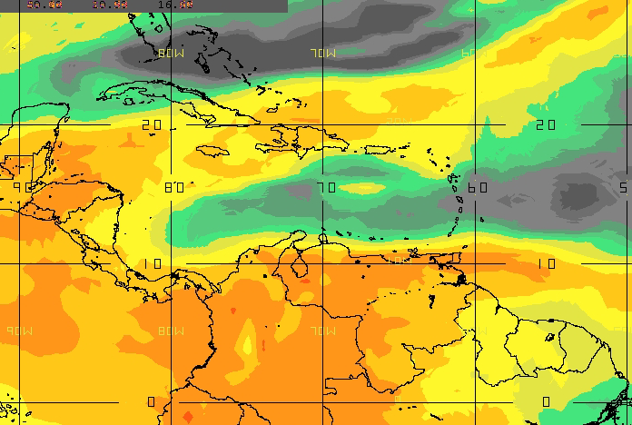
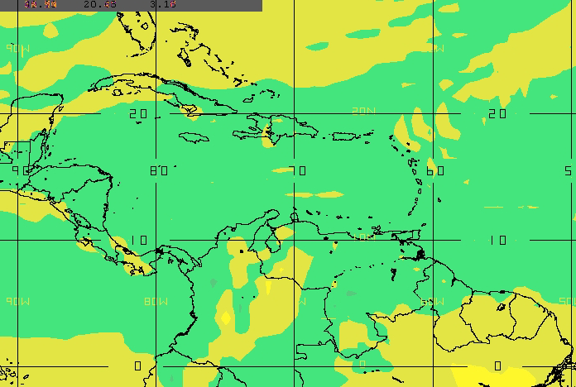
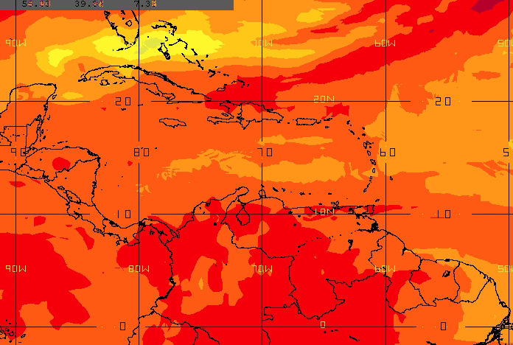
Example 2
Nov.5.2012
IR4 (observed)
IR4
GDI
Temperature Scale in C
CAPE/50
K
Intercomparison
Lifted+20
Totals
52/57

Slide 54
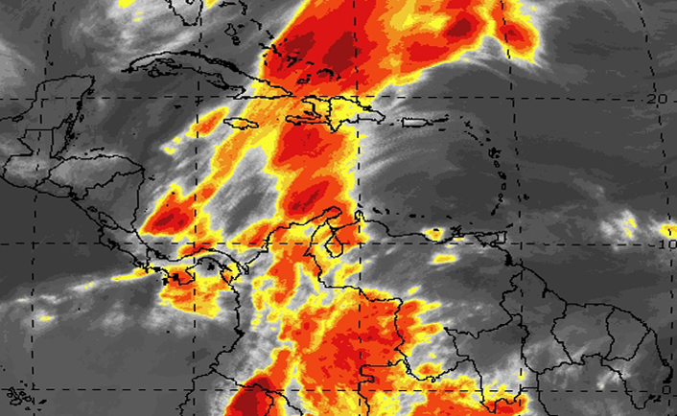
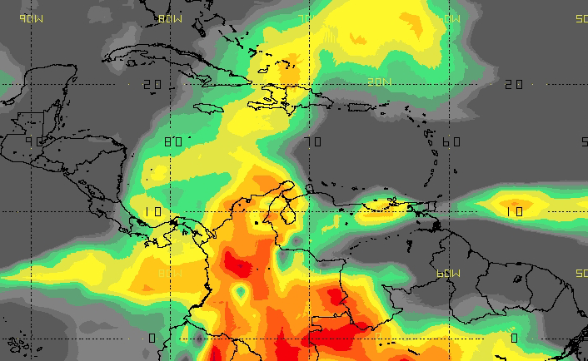
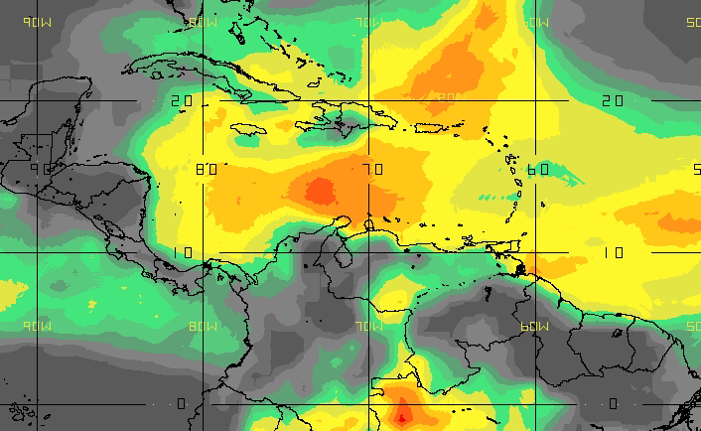
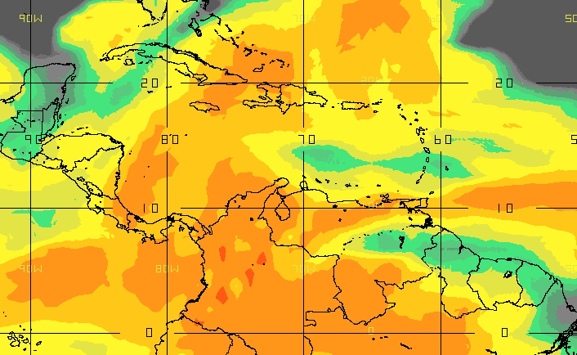
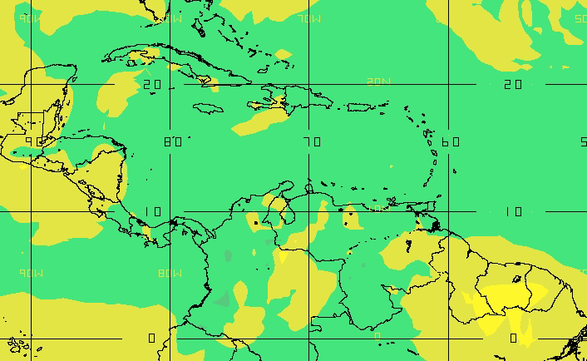
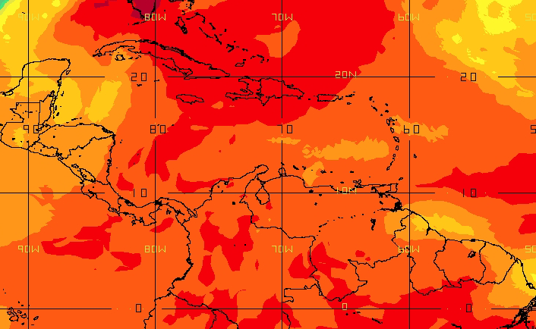
Example 3
Nov.17.2012
IR4 (observed)
GDI
Temperature Scale in C
CAPE/50
K
Intercomparison
Lifted+20
Totals
53/57

Slide 55
Preliminary Results
GDI is promising for rapid evaluation of the potential for different convective regimes in the Caribbean and Tropics in general.
When applied to model data, the GDI depends on model output skill.
If model forecasts are skillfull, the GDI will be too.
Works better than the K especially in regions close to the ITCZ/NET, since the K is not able to represent the fine structure of convection in areas where deep moisture is the norm.
Although orography corrections are for visualization purposes mainly, still shows better results than the K.
54/57

Slide 56
Does the GDI work in South America?
55/57

Slide 57
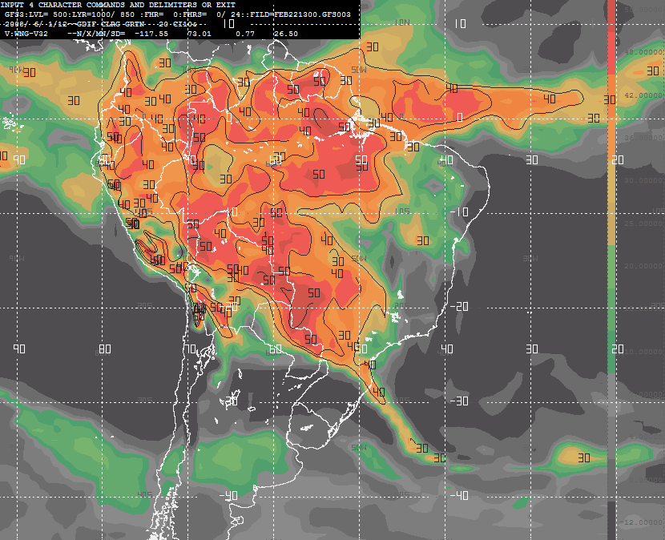
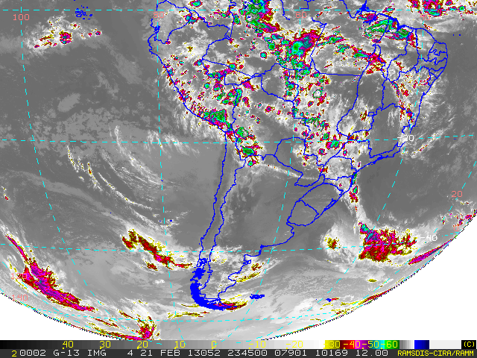
Feb 22, 2013
56/57

Slide 58
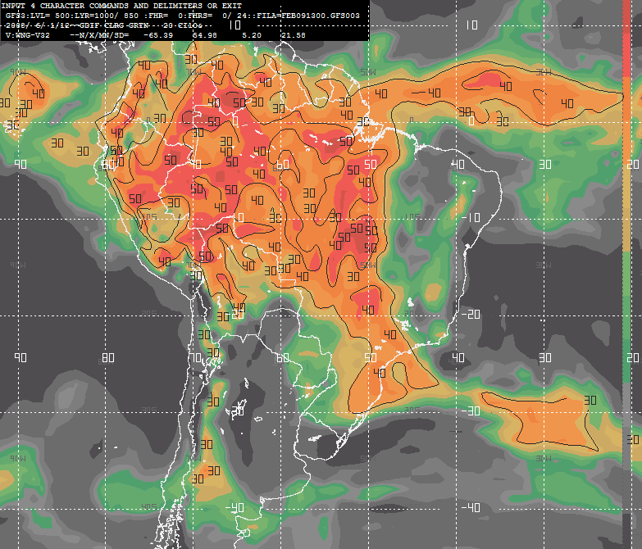
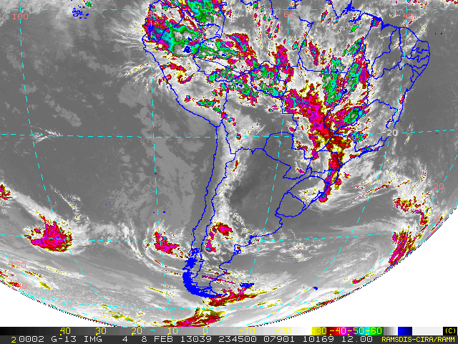
Feb 09, 2013
57/57

Slide 59
¿Questions?

Slide 60
Test

Slide 61
Questions
What are the limitations of the Parcel Method?
What advantages are provided by other thermodynamic methods over the Parcel Method?
Why does the K index work better than other traditional indices over the tropical atmosphere?
Why do high values of CAPE are typically observed over the Caribbean?
When is the column convectively stable?
When is the column convectively unstable?
What advantages does the GDI have over the K?

