Slide 1
Ejercicio Practico: Evento del 20 de Abril del 2004

Slide 2
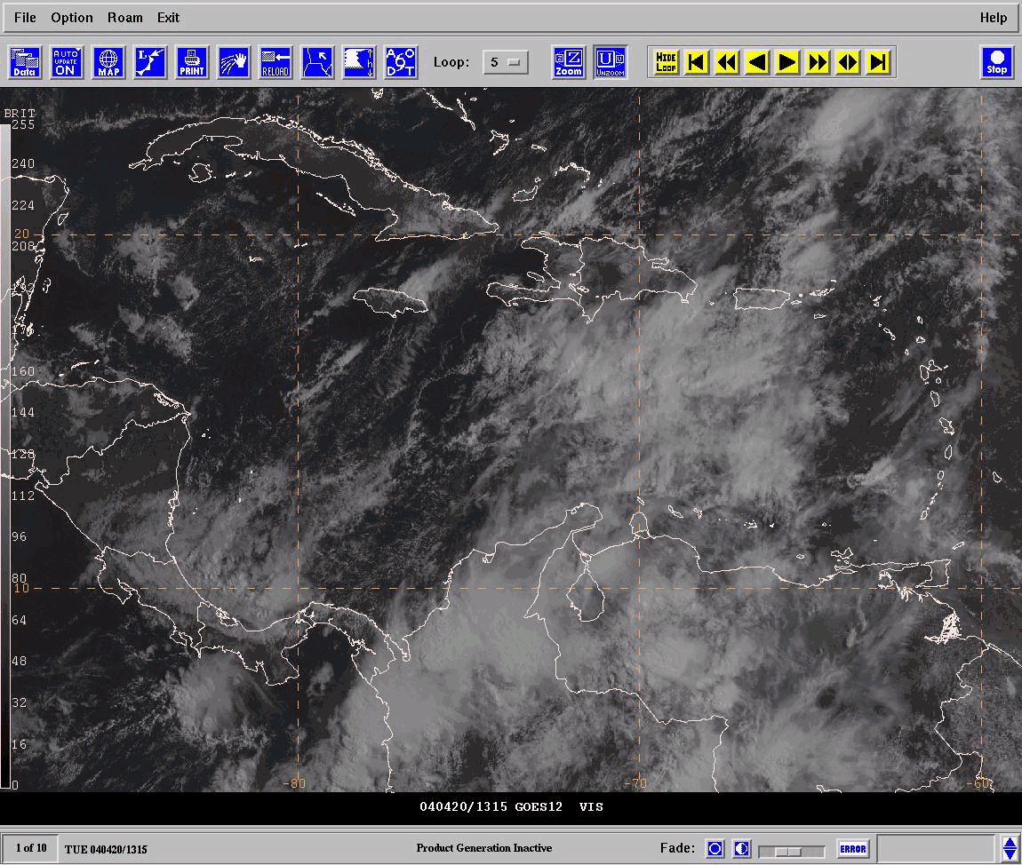
Animación de Imágenes Visibles: Evalué Circulación en Niveles Bajos
Flujo de Bajo Nivel
Notes:
Ignore the high Ci/CS shield and focus on the low level cloud cover. As evident on the animation, moisture is rotating cyclonically (inverted trough) across the Windward Islands, 15N 69W, to Western Panama/Costa Rica. Deep convection is building along the apex (base) of the trough over the Caribbean just south of Puerto Rico and Hispaniola, and across Western Panama and Costa Rica as moisture converges on the Caribbean Plains. Other convection is evident across northern Colombia and Northw

Slide 3
Animación de Imágenes Visibles: Evalué Ventilación en altura
Notes:
This time, try to ignore the low level cloud field and concentrate on the motion of the high clouds (Ci/CS). You should be able to see the anticyclonic outflow across northern South America/eastern Caribbean Islands. Cloud swirls in the vicinity of the Cayman Islands are also suggestive of the upper level circulation, but in this particular example, the visible imagery is not the best tool for diagnosing the pattern.

Slide 4
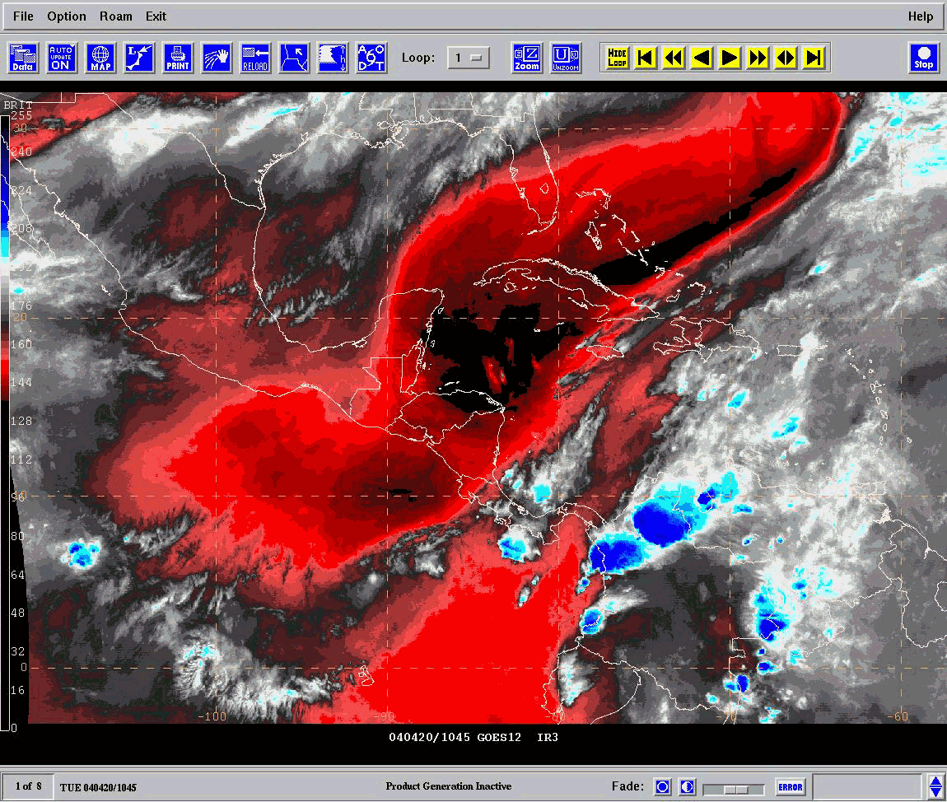
Animación Vapor de Agua (Circulaciones en Altura)
C
Notes:
The water vapor imagery, due to the placement of the GOES near the equator, is mostly representative of upper level circulations. In this case, the enhanced imagery clearly shows the cyclonic circulation over the western Caribbean, and the anticyclonic outflow over the eastern Caribbean.

Slide 5
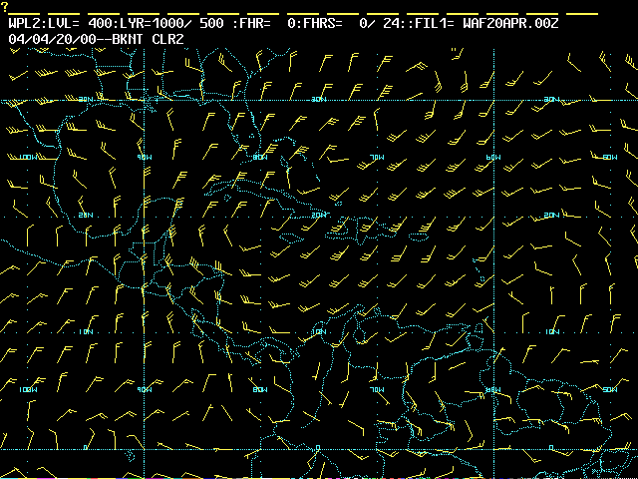
GFS Análisis en 400 hPa: Flujo en Altura
TUTT
ST Ridge
SE Ridge
Notes:
The GFS analysis, at 400 hPa, clearly shows the upper level circulations, with a Trough over the western Caribbean and a ridge on the eastern Caribbean/Tropical Atlantic. The best diffluence aloft is over and north of the eastern Caribbean islands.

Slide 6
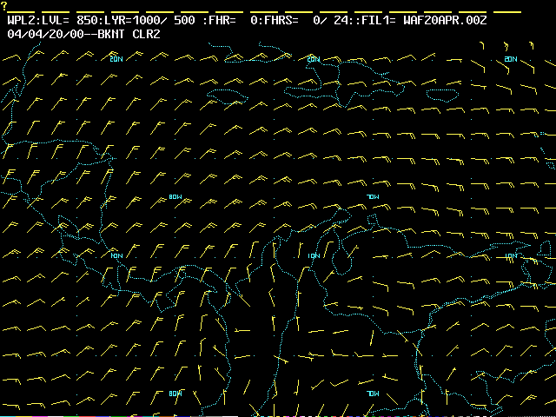
GFS Análisis en 850 hPa: Flujo en Niveles Bajos
“V” Invertida
Notes:
The 850 hPa analysis shows a cyclonically curved flow over the eastern/central Caribbean, with the inverted trough extending north from northern Colombia to Haiti.

Slide 7
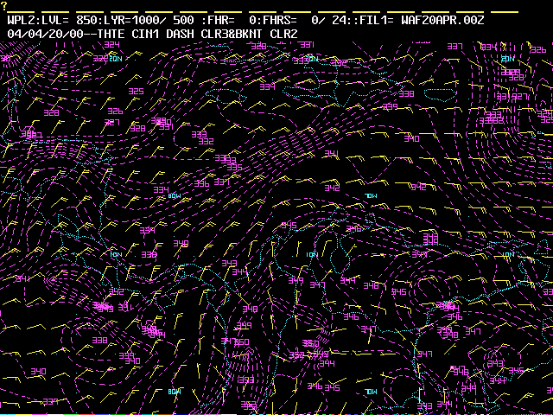
Vientos y TEP (θe) en 850 hPa
Caliente y Húmedo
Caliente y Húmedo
Notes:
The plot of equivalent potential temperature (EPT) and the 850 hPa winds, shows a warm/moist ridge extending north-northeast from northern Colombia/northwestern Venezuela to Puerto Rico/US Virgin Islands. The shape of the moist tongue is due to the combination of the upper trough and the ridge.

Slide 8
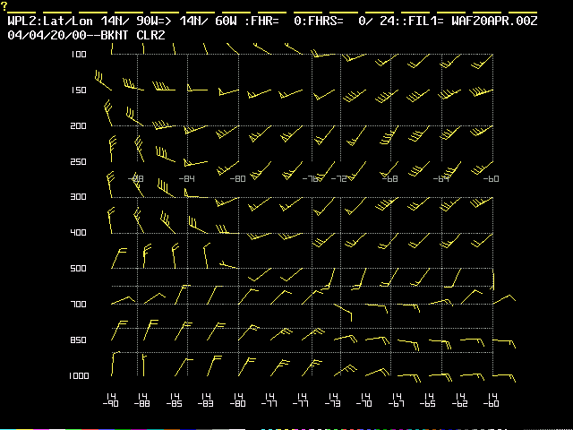
Corte Transversal: Vientos
TUTT
“V” Invertida
Notes:
The upper and low level troughs are clearly evident on the vertical profile. The low level perturbation is under the influence of the upper level synoptic scale perturbation.

Slide 9
Observaciones
Evaluación de las imágenes visibles muestran una vaguada invertida en capas bajas.
La imágenes visible claramente muestran una perturbación en niveles bajos, pero no es evidente que se asocia a un sistema de capas altas.
Por ello, podría fácilmente ser confundida con una perturbación en los alisios/onda Tropical.
La imagen de vapor de agua, en combinación con la imágenes visibles, claramente muestra la vaguada en altura con una dorsal al este.
Ello sugiere una dependencia de la perturbación de capas bajas de la vaguada en la atmósfera superior.
Esto se puede confirmar con el corte transversal del campo de viento.

Slide 10
Ejercicio Practico: Evento del 20 de Junio del 2008

Slide 11
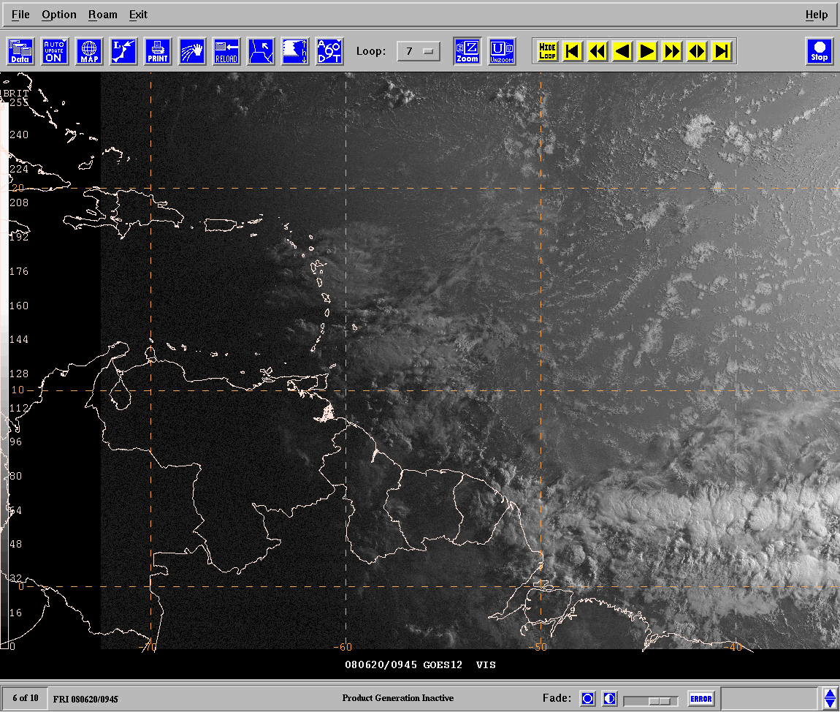
Animación de Imágenes Visibles
“V” Invertida
Notes:
Visible animation shows a skewed low level ridge into the Tropical Atlantic, with axis to the southeast to just north of the ITCZ. A well defined perturbation is entering the eastern Caribbean isles, with inverted “V” pattern defining from eastern Venezuela to the Virgin isles. Note that this is anomalously strong this early in the season. Higher amplitude waves like this are more common in late August/September.

Slide 12
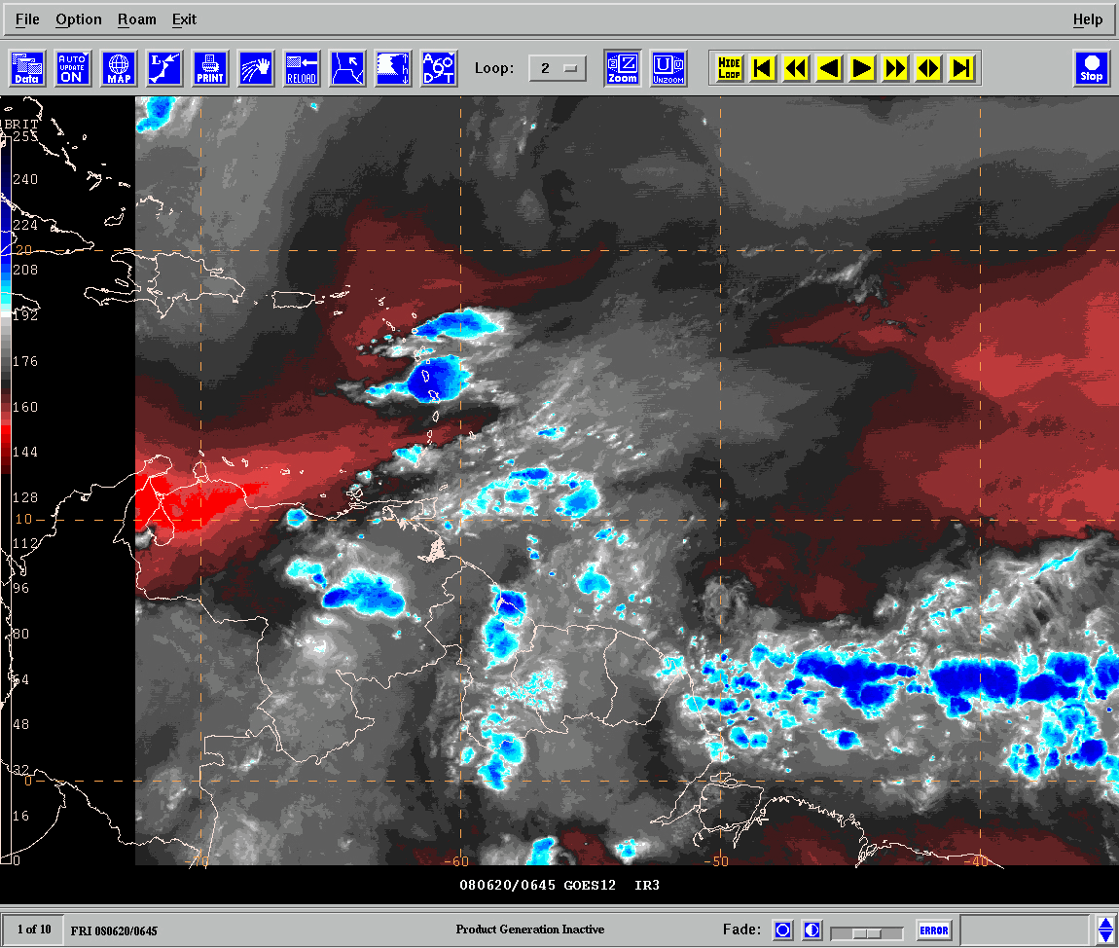
Animación Vapor de Agua (Circulaciones en Altura)
Baja
TUTT
Dorsal SE
Notes:
Water vapor images show a TUTT with its axis southwest across the northern Leeward/Virgin Isles to a low over the northeast Caribbean. A ridge extends from the east across the Tropical Atlantic to just east of the islands. The ridge aloft is venting deep convection along the ITCZ while also sustaining a deep layer easterly flow steering deep convection towards the Guianas/northern Venezuela.
The TUTT low is providing the outflow to deep convection over the Lesser Antilles while enhancing convection along the Tropical Wave.

Slide 13
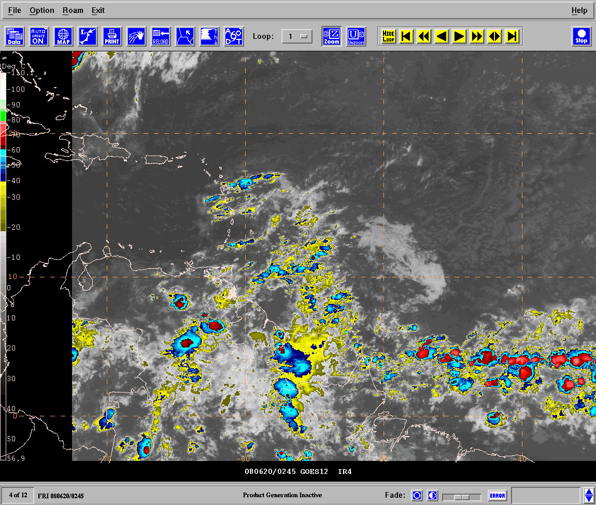
Animación Infrarroja
“V”
Invertida
Notes:
On the IR animation the upper circulation is barely visible, and the low level inverted trough pattern can be inferred from the cloud motion. But this is not the best tool for finding the wave axis nor the upper circulations. It is best used for identifying cloud tops (cold tops).

Slide 14
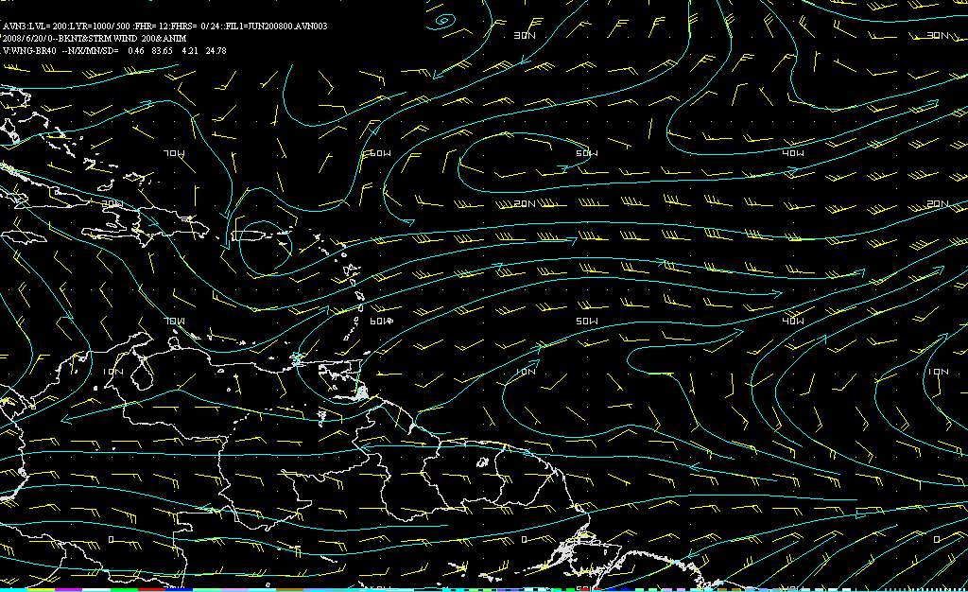
GFS Análisis: Vientos en 200 hPa
TUTT
Notes:
The corresponding model analysis at 200 hPa shows the TUTT over and northeast of the islands, while a broad ridge traverses the Tropical Atlantic. This is consistent with the previously noted flow pattern on the water vapor imagery. (Also shows good model initialization of the upper features)

Slide 15
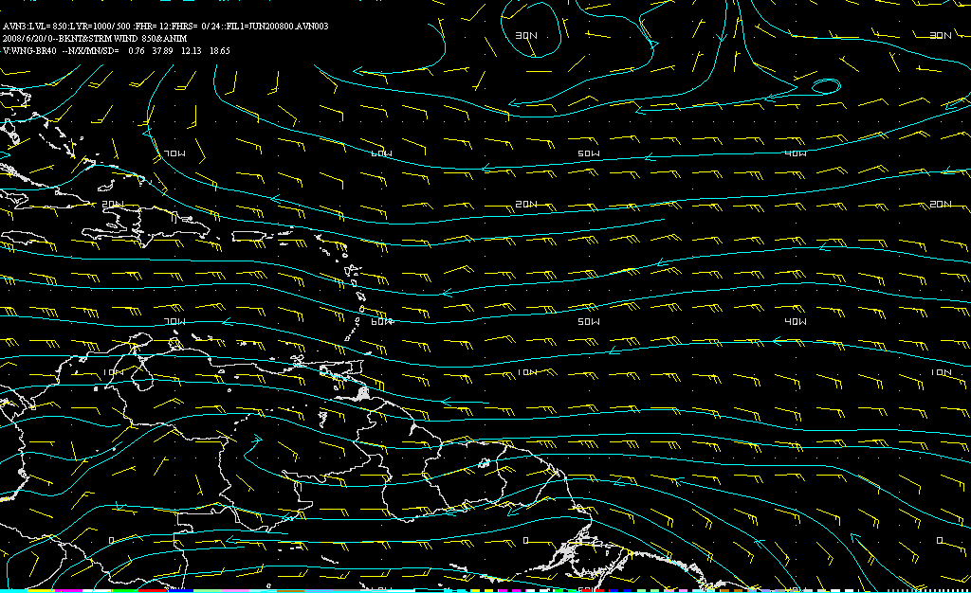
GFS Análisis: Vientos en 850 hPa
“V”
Invertida
Notes:
The corresponding model analysis at 850 hPa shows the inverted trough (“V”) moving across the eastern Caribbean… while being steered by a ridge to the north. This is consistent with satellite interpretation (visible images).

Slide 16
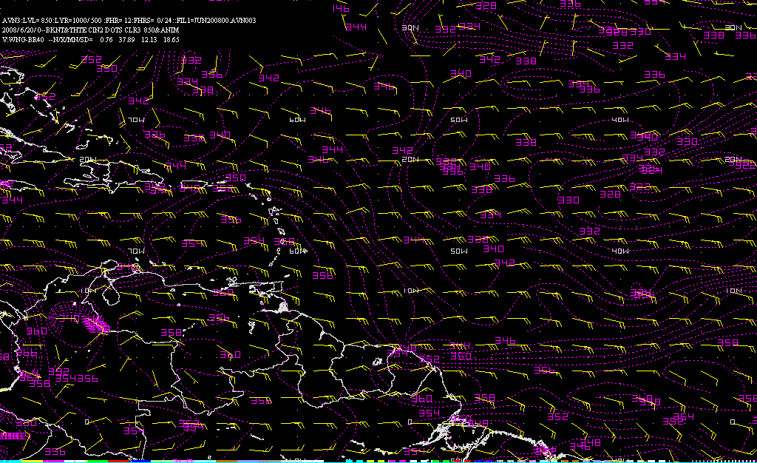
Vientos y TEP (θe) en 850 hPa
Caliente y Húmedo
Notes:
The corresponding model analysis at 850 hPa shows the inverted trough (“V”) moving across the eastern Caribbean, and a THTE/EPT ridge concentrating along the wave axis. This shows/suggests dependence on high moisture/heat content to sustain the wave, and potential for organized rainfall over the islands.

Slide 17
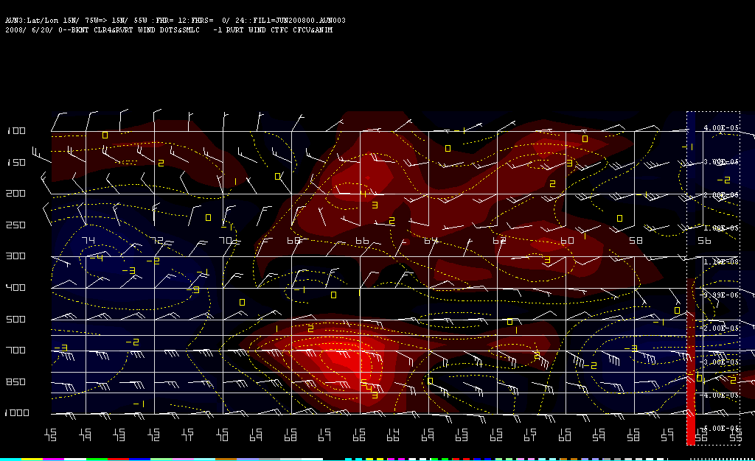
Corte Transversal:
Vientos y Vorticidad Relativa
TUTT Sobre los 300 hPa
“V”
Invertida
Notes:
This is a cross section of the wind (barbs/kt) and the relative vorticity (cyclonic in red). The cross sectional analysis shows the upper level trough and the low level perturbation. The upper trough extends only down to near the 250-hPa leve, while the low level perturbation reaches 500 hPa. This is unusually deep for a Tropical Wave, as they normally confine to levels below 700 hPa. Notice the model analysis/forecast of a wind surge to the east of the axis, with winds of 40kt at 700 hPa.

Slide 18
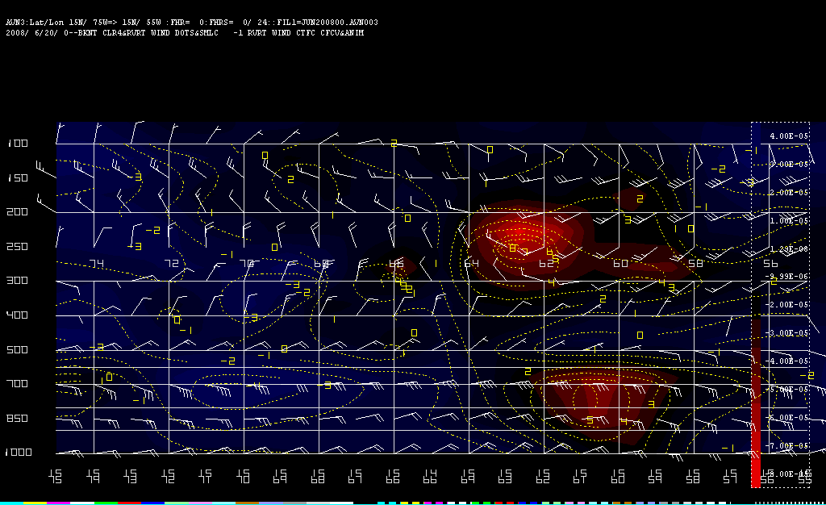
Animación:
Vientos y Vorticidad Relativa
Segun el modelo GFS, la vaguada en capas bajas se mueve independiente de la en altura.
Notes:
In this animation, a cross section of the wind (barbs/kt) and the relative vorticity (cyclonic in red), one can clearly see how the low level perturbation is propagating independently from the upper level axis. Although the TUTT interacts with the Tropical Wave, it is not deep enough to interfere with its westward motion.

Slide 19
Observaciones
Imagen visible y la de IR muestran una vaguada invertida en los alisios de capas bajas.
La imagen de vapor de agua muestra una TUTT.
Animación de las imágenes de satélite y pronósticos del modelo, nos indica que la perturbación en los alisios se propaga independientemente de la de niveles superiores.
Pero hay una interacción positiva entre los dos sistemas de diferentes escalas, con fuerte convección en las Leeward Islands (Islas de Barlovento).

Slide 20
Ejercicio Practico: Evento del 06 de Agosto del 2008

Slide 21
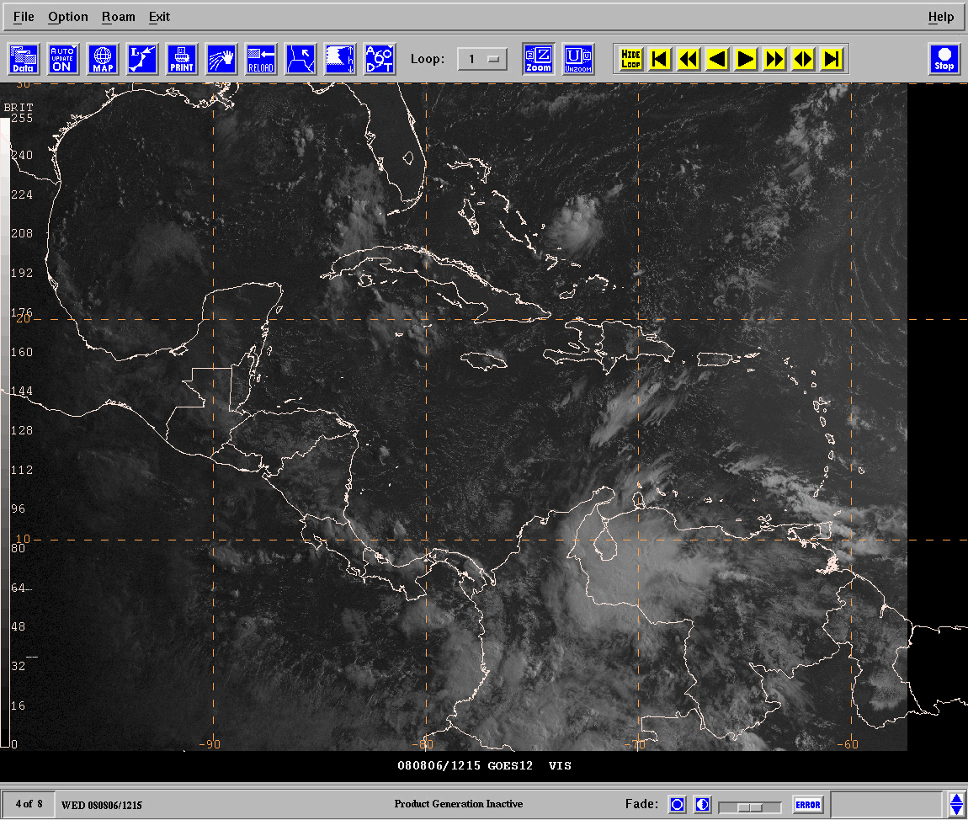
Animación de Imágenes Visibles
Baja
TUTT
“V”
Invertida
Notes:
In this animation of visible images, one can clearly see an inverted trough in the low level easterlies, with axis north from wrn Venezuela to Haiti/southeast Bahamas-Turks. This wave, as it commonly happens, was enhancing deep convection around lake Maracaibo region in Venezuela.
A cyclonic circulation is also evident to the north, dominating flow across the Bahamas/Cuba. The circulation is so strong/well defined that it gives impression it might be a low level feature.
Note that the low level perturbation and trough/low pattern over the Bahamas seem to be moving in-tandem.

Slide 22
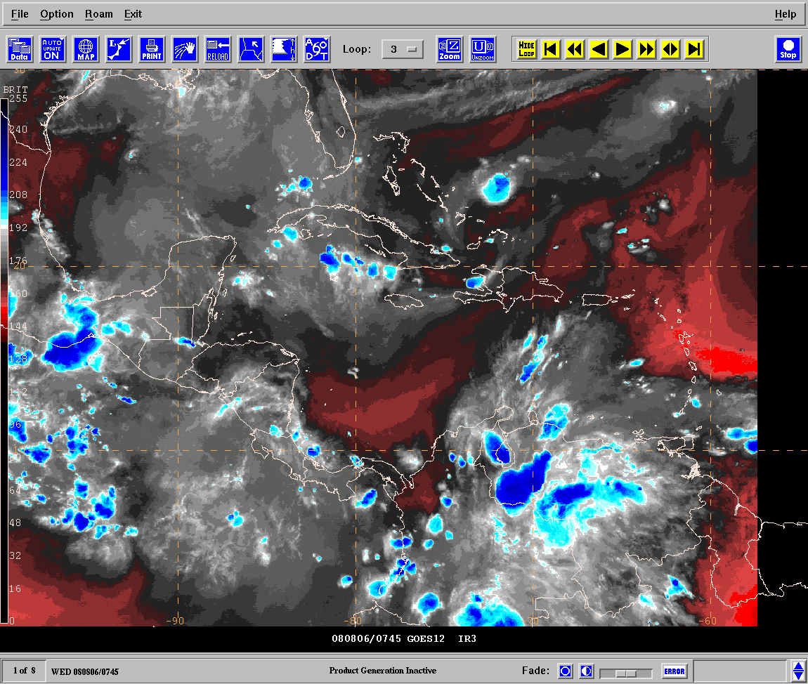
Animación Vapor de Agua (Circulaciones en Altura)
Baja
TUTT
Notes:
Evaluation of the water vapor images clearly shows that the circulation over the Bahamas/Cuba is indeed an upper level circulation and not a low level circulation. The trough axis clearly extends into the central Caribbean, and it is enhancing convection with the previously noted perturbation over Venezuela. The trough is also enhancing sea breeze convection across Cuba.

Slide 23
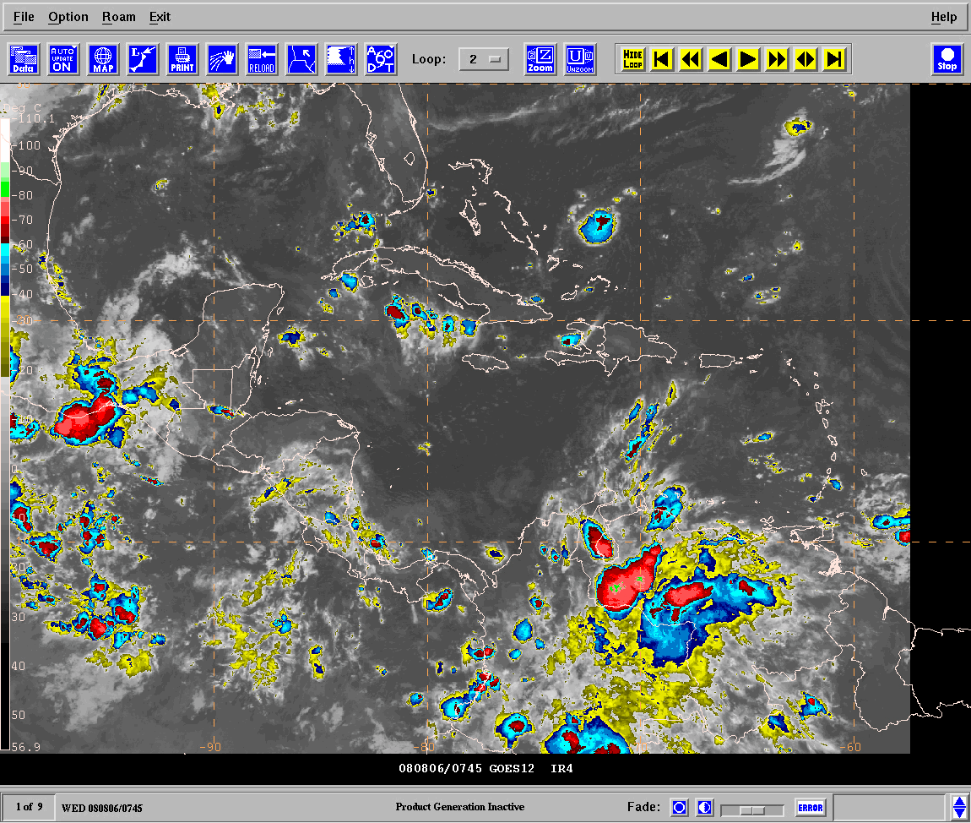
Animación Infrarroja
Baja
TUTT
“V”
Invertida
Notes:
The IR image shows the inverted trough moving across Venezuela to Colombia, while also showing the TUTT induced ventilation across northern South America into the central Caribbean.
Note that the low level perturbation and upper level trough pattern seem to be moving in-tandem.

Slide 24
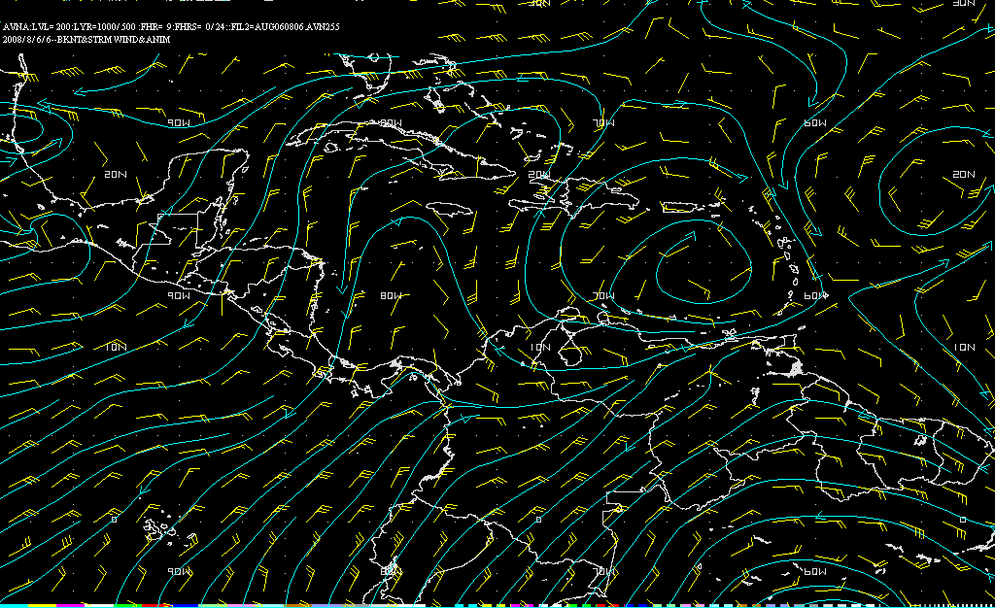
GFS Análisis: Vientos en 200 hPa
C
A
Notes:
Model analysis at 200 hPa shows an inverted trough extending across Panama-Jamaica-ern Cuba to a low over the Southeast Bahamas. A ridge lies to the east over the ern Caribbean/nrn Venezuela.

Slide 25
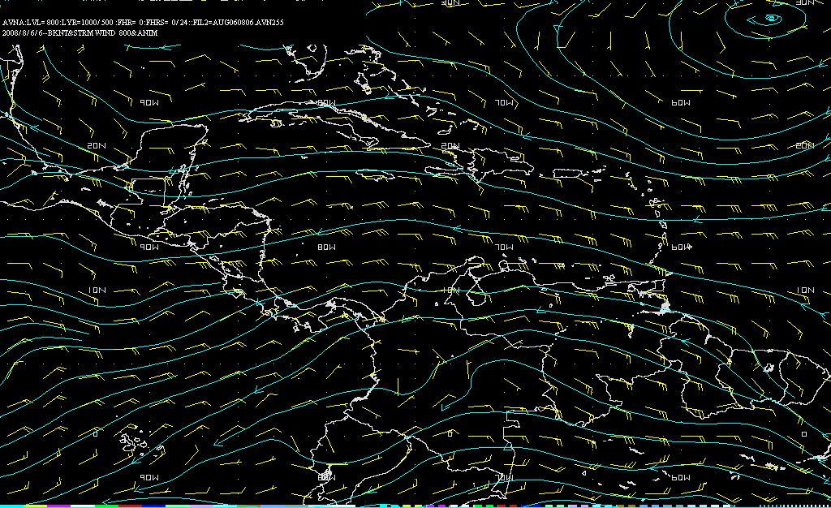
GFS Análisis: Vientos en 850 hPa
Notes:
At 800 hPa the inverted trough pattern is well defined, extending from nrn Colombia to the Bahamas.

Slide 26
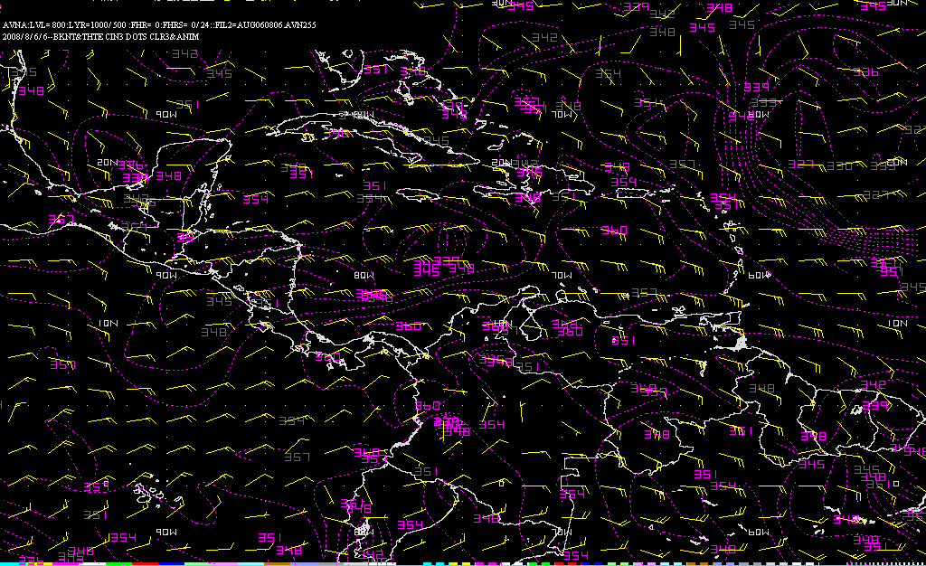
Vientos y TEP (θe) en 850 hPa
Notes:
The 800 hPa analysis of the winds and the equivalent potential temperature also show the inverted trough axis, with a thermal ridge concentrating along the inverted trough. The low level feature is interacting with the Near Equatorial Trough over nrn South America to sustain a warm/ moist inflow across the central Caribbean. Presenting a risk of organized rainfall amounts.

Slide 27
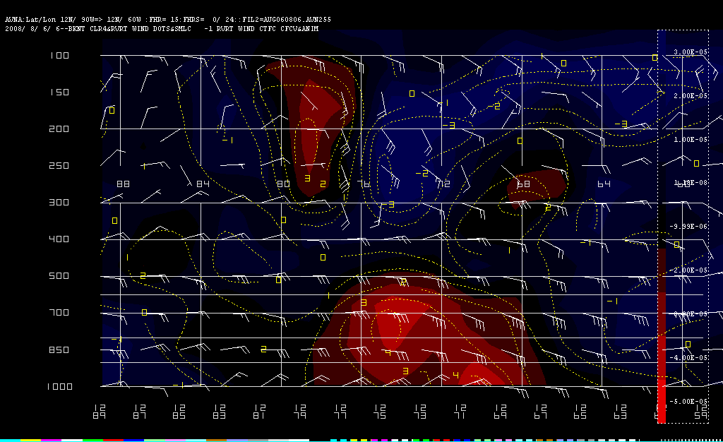
Corte Transversal:
Vientos y Vorticidad Relativa
TUTT Sobre los 300 hPa
“V”
Invertida
Notes:
This is a cross section of the wind (barbs/kt) and the relative vorticity (cyclonic in red). The cross sectional analysis shows the upper level trough and the low level perturbation. The upper trough is limited to levels above 300 hPa, while the low level perturbation reaches 500 hPa. Notice the model analysis/forecast of a wind surge to the east of the axis, with winds of 40kt at 700 hPa.
The upper and low level troughs are clearly evident on the vertical profile. The low level perturbation is interacting with the upper level synoptic scale perturbation.

Slide 28
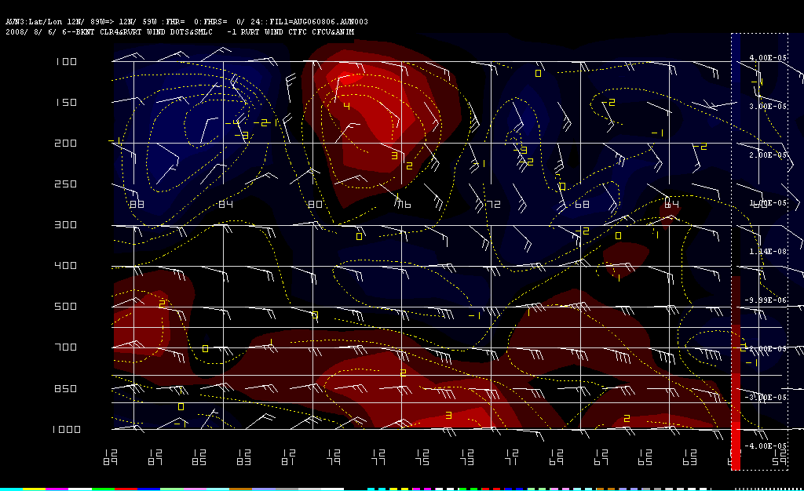
Animación:
Vientos y vorticidad relativa
Vaguadas en nivel bajo y alto moviendose en conjunto.
Notes:
The cross sectional analysis of the winds and vorticity adds to the confusion. It is clearly evident that the low/upper perturbations are moving in tandem. But, with time notice that the upper low weakens/fills while the low level trough tends to persist. The likely explanation was that the surface/low level trough was indeed a tropical wave that was in phase with the upper level trough axis.
The other possibility is that the low level trough was an induced wave, and managed to survive the dissipation of the upper level axis.

Slide 29
Observaciones
Baja TUTT en altura apoya profunda vaguada en la cuenca del Caribe.
Imagen visible y flujo en capas bajas claramente muestra perturbación en los alisios.
Perturbación en bajo nivel aparenta estar en fase con núcleo ciclónico en altura.

Slide 30
Resumen

Slide 31
¿Onda Tropical o Vaguada Inducida por una TUTT?
¿Cómo discernir si es una vaguada inducida?
Se forma en lugar/sitio.
Si se mueve, lo hace en conjunto con perturbaciones en altura.
Importante ver evolución (uso de análisis previos/continuidad).
Se tiende a disipar según se disipa la TUTT.
¿Cómo reconocemos una onda tropical?
Sus orígenes son de África,
Ver diagrama Hovmöller en la dirección:
http://www.nhc.noaa.gov/analysis_tools.shtml
Se propaga independientemente de sistemas en altura.

Slide 32
Interacción entre una onda tropical y una TUTT
¿Puede una onda tropical interactuar/juntarse con una vaguada inducida?
SI: Pero la circulación inducida en capas bajas puede terminar “enmascarando” la onda tropical aparentando ser solo una onda inducida.
Algo parecido se observa en el Caribe Sur/Panamá, donde vaguada semipermanente de capas bajas hace difícil darle seguimiento a las ondas
POSIBLEMENTE: Según la onda tropical se avecina a la vaguada en altura, es probable que experimente cortante en la vertical. En algunas/varias ocasiones la onda tropical se disipa mientras que la inducida persiste.
NO: Una onda tropical potente/bien organizada puede retener su integridad según se acerca a la vaguada en altura. Pero esto depende de la intensidad y/o profundidad de la vaguada en altura.
Mientras más profunda sea la vaguada en altura, menor la probabilidad de la onda del este sobreviva.

Slide 33
¿Preguntas?

Slide 34
Prueba

Slide 35
Preguntas
¿Una vaguada de núcleo frío que se extiende desde la superficie a niveles medios/superiores es una TUTT?
¿Las imágenes de vapor de agua, nos sirven para identificar circulaciones de niveles bajos?
¿Ondas tropicales y vaguadas inducidas en los alisios de capas bajas son lo mismo?
¿Qué función tienen las TUTTs para la convección en la cuenca del Caribe?
¿Por qué vemos altos valores de temperatura equivalente potencial en las ondas tropicales y las vaguadas inducidas?
¿Cuándo hay interacción negativa/positiva entre una TUTT y una onda tropical?

Slide 36
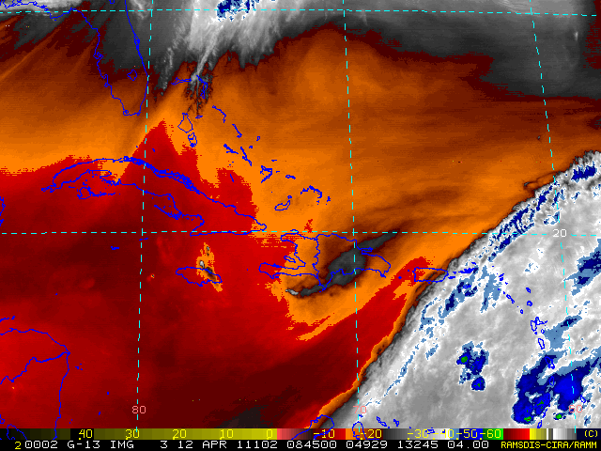
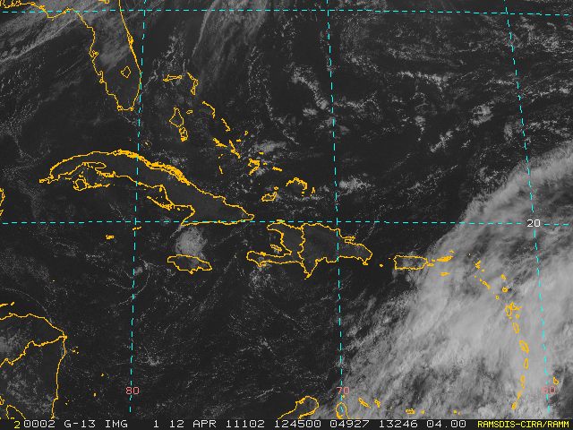
Evalué las animaciones WV/Vis. ¿Perturbación en el Caribe, es TUTT inducida u onda tropical?

Slide 37
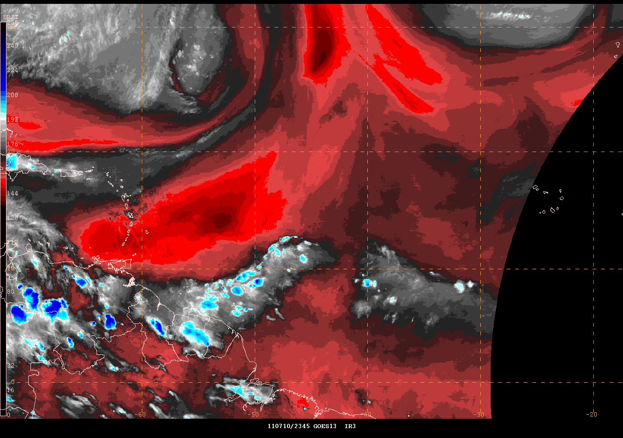
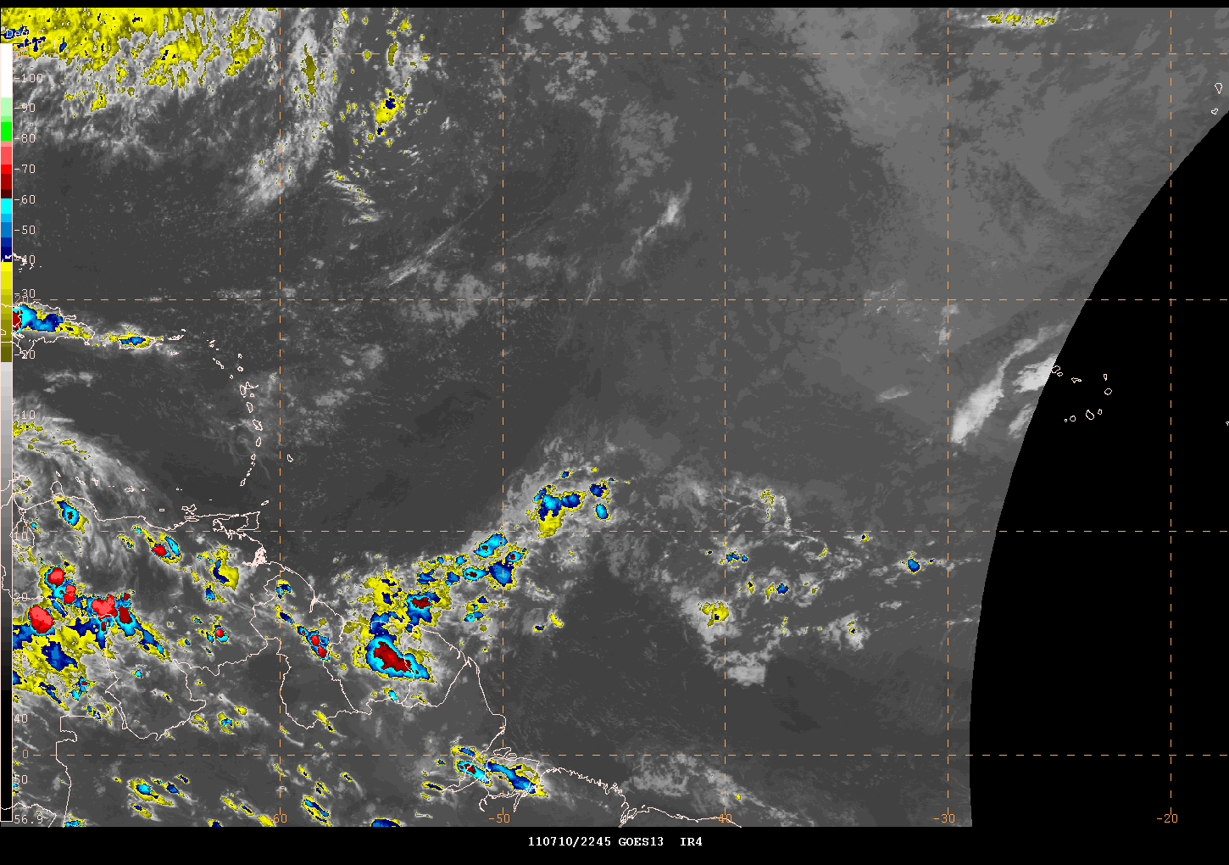
Evalué las animaciones WV/Vis. ¿Perturbación del Atlántico es TUTT inducida u onda tropical?

Slide 38
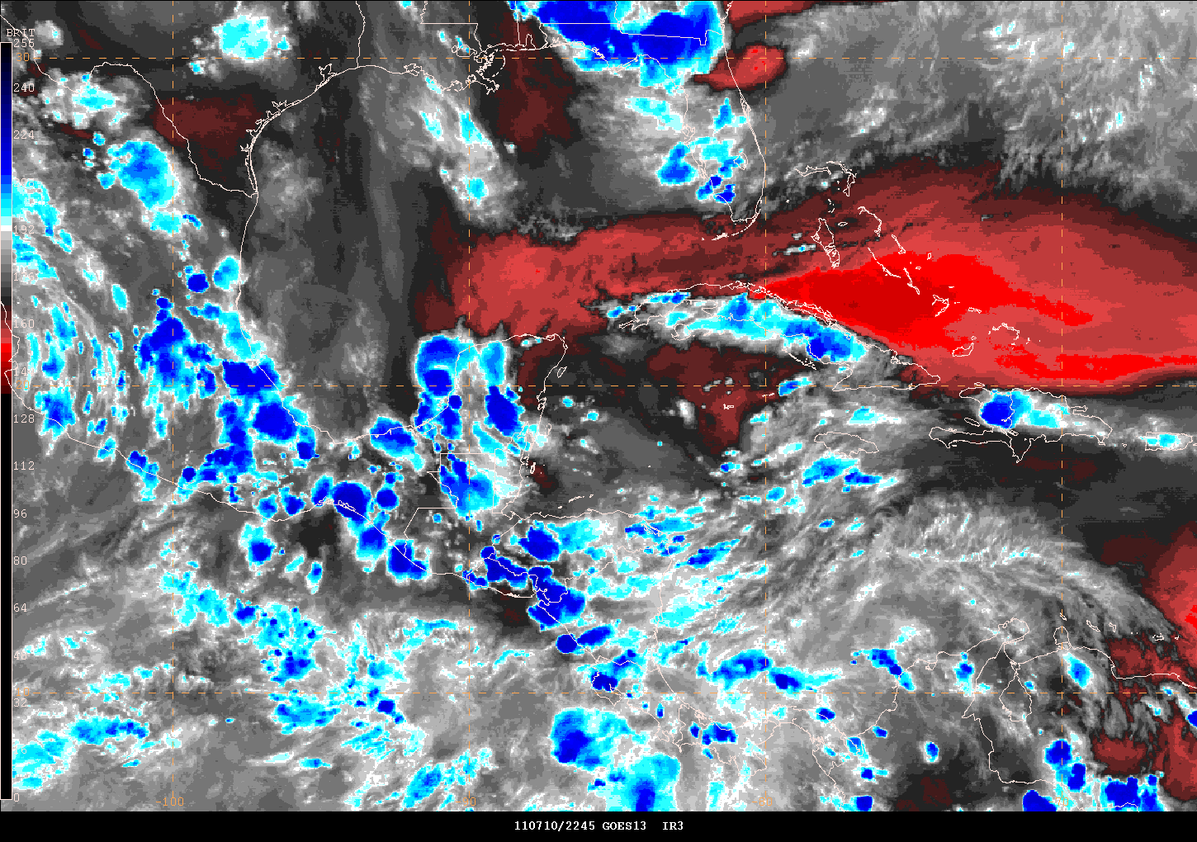
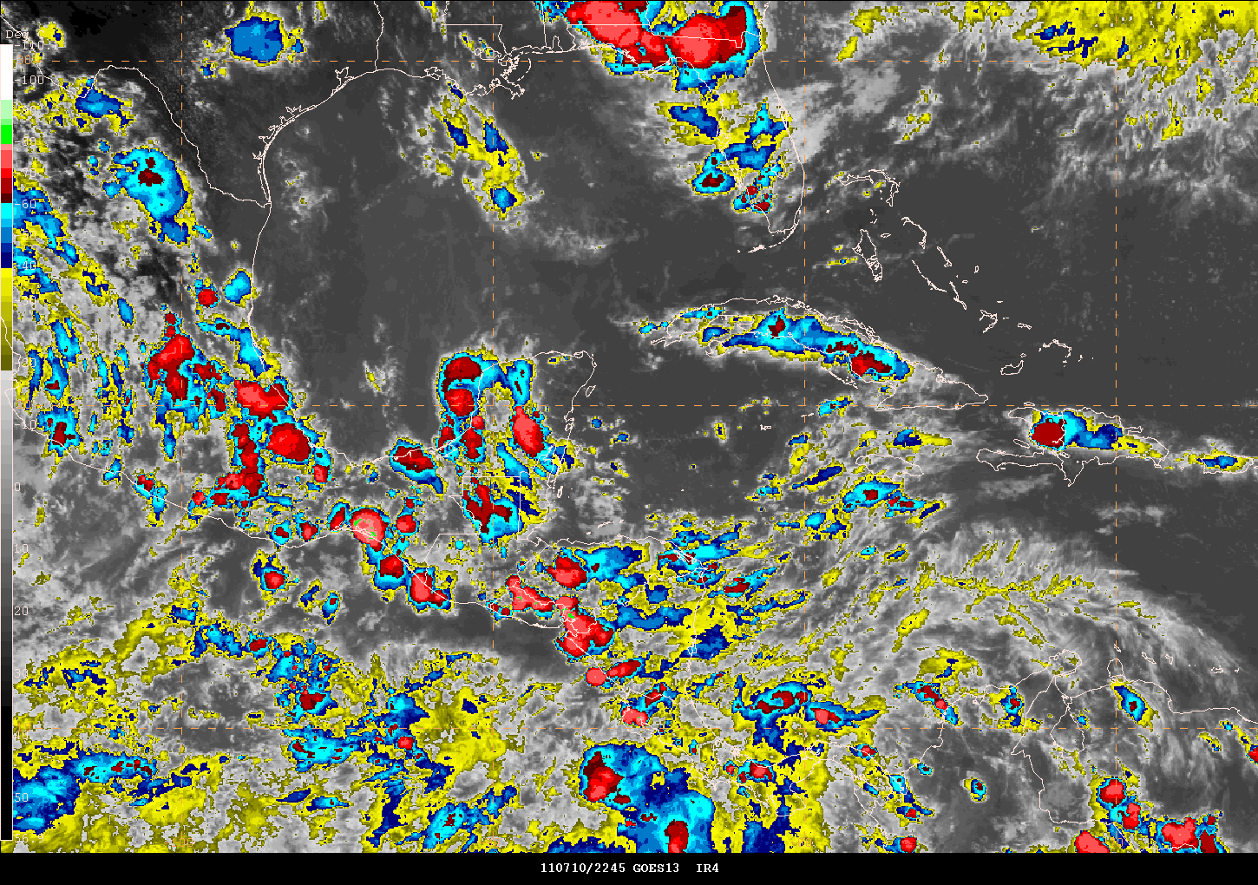
Evalué las animaciones WV/Vis. ¿Perturbación en el Caribe, es TUTT inducida o onda del este?

Slide 39
Referencias
NWS Southern Region Forecaster Notes Number 5, 01 September 1992. Easterly Waves, or TUTT Lows? Sources of Confusion over the Atlantic, Puerto Rico, and along the Gulf Coast in Summer.
USAFETAC/TN-89/003, The Caribbean Basin, A Climatological Study, December 1989
AFCC Theater Climatic File CD. Volume 4: South America, South of the Amazon River, Ver. 1.0 June 1998.
Burpee, R.W., 1972: The origin and structure of easterly waves in the lower troposphere of North Africa. J. Atmos. Sci., 29, 77-90.
Dvorak, V.F., 1975: Tropical cyclone intensity analysis and forecasting from satellite imagery. Mon. Wea. Rev., 180, 1915-1923.
Riehl, H., 1945: Waves in the easterlies and the polar front in the tropics. Misc. Rep. 17, Dept. Meteor., Univ. Chicago. 79 pp.
_____, 1954: Tropical Meteorology. Mcgraw-Hill Book Co., New York, NY. 392 pp.
Graphics generated using the Wingridds/PcGridds software to display the GFS/AVN global model.
Satellite images provided by NOAA/NESDIS under permission.

